Slide 1
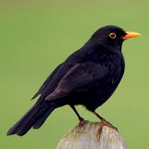
Welcome to Blackbird Class with Mr Phillips!
Aim High. Stay Safe. Be Respectful.

Slide 2
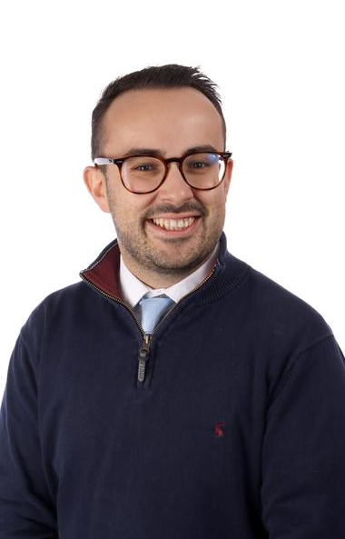
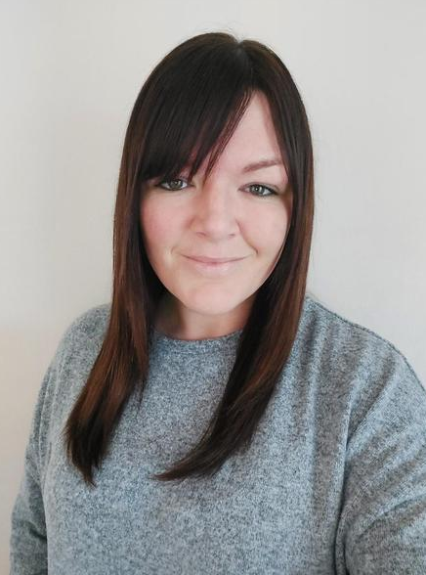
Who will your children be working with?
Class Teacher:
Mr Phillips
Teaching Assistant:
Miss Bell

Slide 3
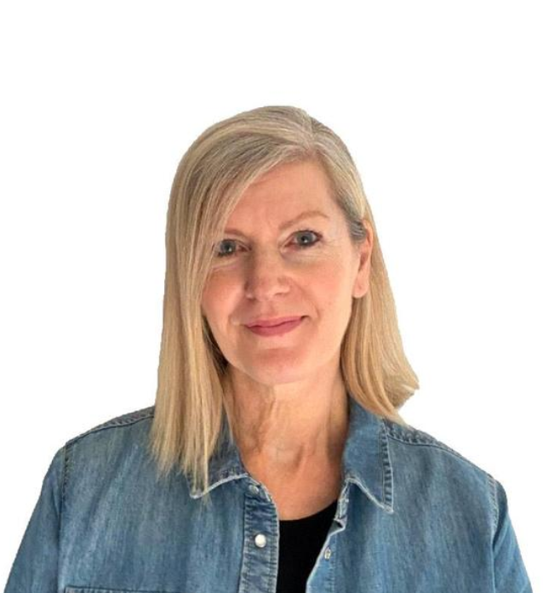
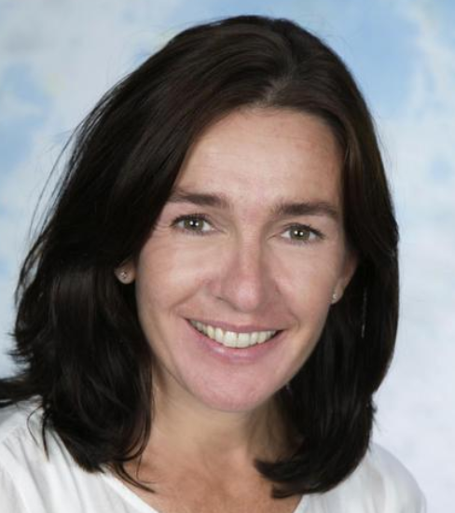
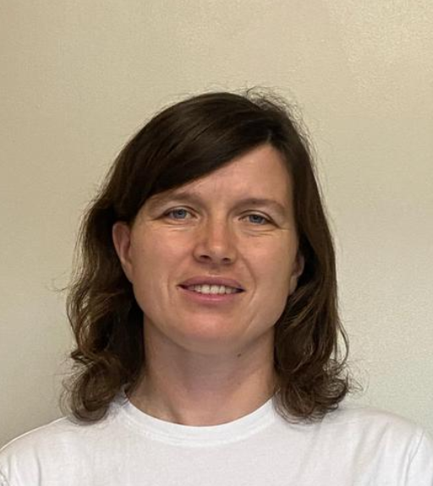
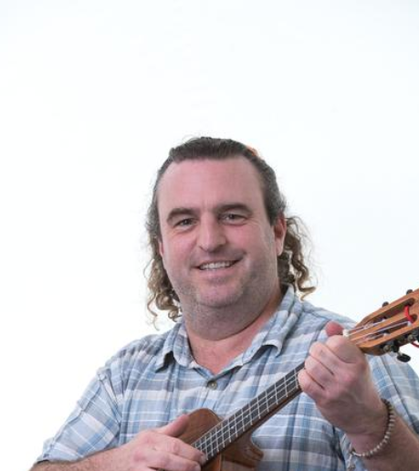
Other teachers your child may have when Mr Phillips is absent:
Mr Connelly (Music)
Mrs Roberts (French)
Miss Weller
Miss Fuller

Slide 4

Curriculum/Experience Highlights?
Aqualab at the River Stour
Class Assemblies
Swimming
Trip to Canterbury Cathedral
Trip to Brook Museum
Learn to play a musical instrument
Grow and eat our own vegetables
And so much more!

Slide 5
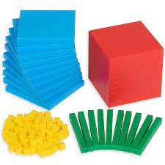
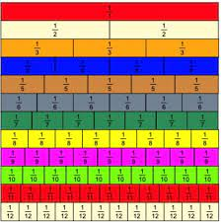
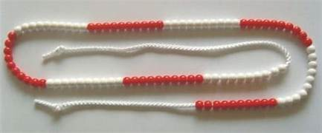
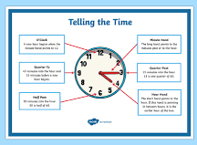
Curriculum – Maths (White Rose)
Autum 1 | Autum 2 | Spring 1 | Spring 2 | Summer 1 | Summer 2
Place Value Addition & Subtraction | Addition & Subtraction Multiplication & Division | Multiplication & Division Length & Perimeter | Fractions Mass & Capacity | Fractions Money Time | Time Shape Statistics

Slide 6

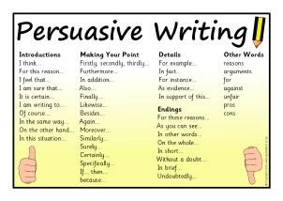
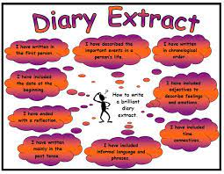

English – Writing
For Term 1 we will be looking at the features of a postcard and our key text for the term The King who banned the dark.
We will teach a range of writing styles including descriptive writing, non-chronological reports, poetry and biographical writing.
We will be doing a lot of editing work to encourage children to continue to improve their writing. We model writing frequently which supports the children’s understanding and improves their confidence when it is their turn.

Slide 7
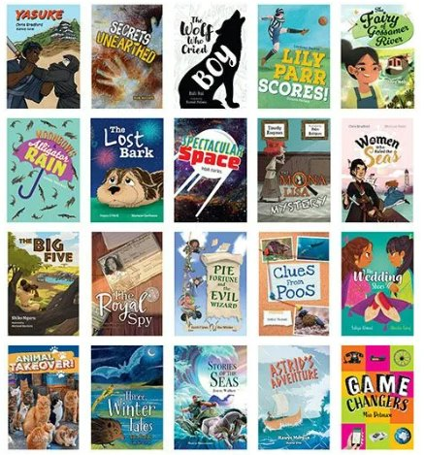

The Curriculum- English: Reading

Slide 8

Accelerated Reader

Slide 9
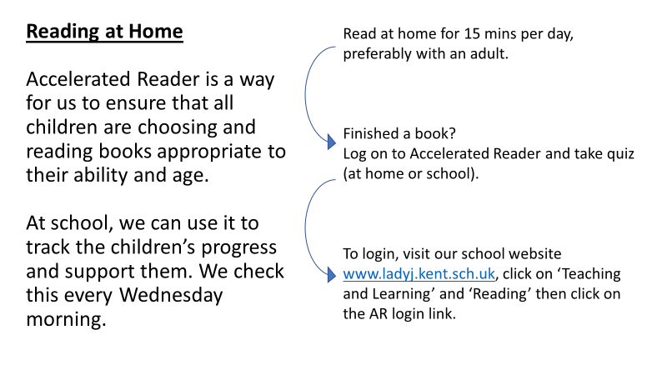

Slide 10
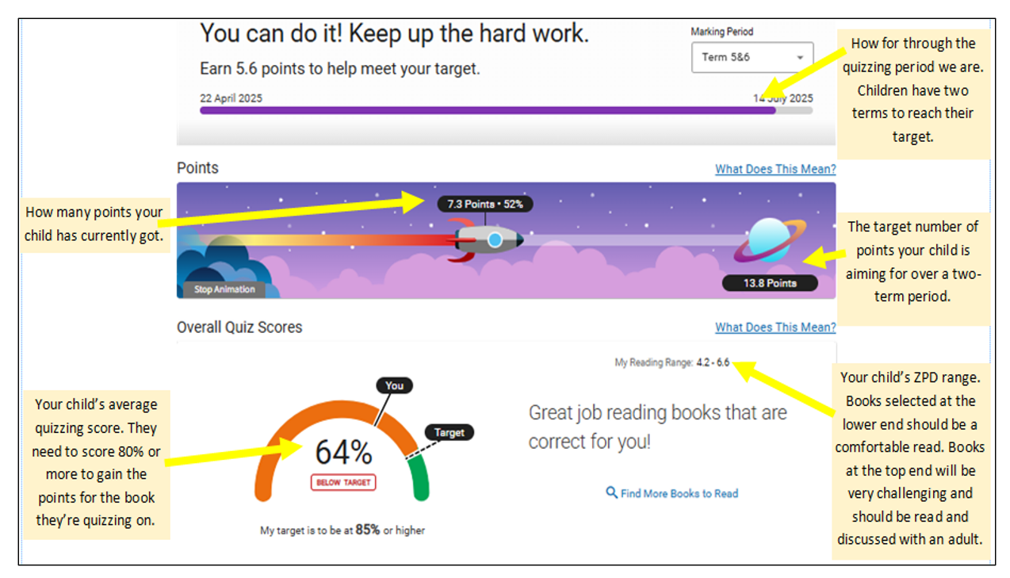

Slide 11

AR Targets
Targets are specifically tailored to your child’s reading ability. Every child who reads for 15 mins a day can reach their target.
Children have two terms to reach this target.
ZPD
This range (2.1-4.1 for example) is tailored to your child. It allows them to select books perfectly within their reading ability.
Books at the lower end should comfortably be read independently.
Books at the upper end should be challenging and read with a adult.
Book Maturity
LY books – maturity age up to 8 year olds (for Year 3s)
MY books – maturity age up to 11 year olds

Slide 12
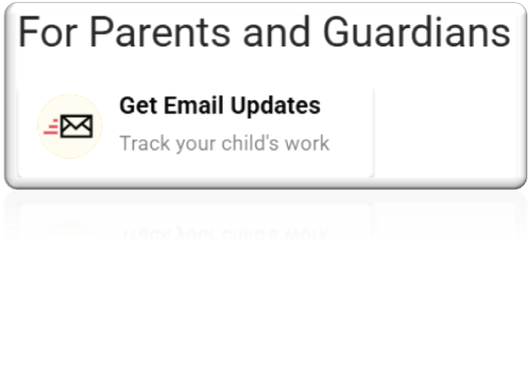
Home Connect
Parents, carers and grandparents can track their children’s reading from home using the website, Home Connect.
Visit our school website www.ladyj.kent.sch.uk
And log on to your child’s reading AR account (please see your child’s teacher if you do know this login)
Scroll down and click on:
Enter your name and email address (6 emails can be added)
Once you’ve confirmed the Home Connect email, you will receive emails about quizzes your child has completed and you can log in to check progress towards your child’s target.

Slide 13



Slide 14

We have been overwhelmed by your generous response to our 50 Books to Read Before You Leave Year 3 project.
Some of the books we still need are:
A Mermaid's Diary
The Creakers
The Shape of Rainbows
The Boy Who Stole the Pharoah's Lunch

Slide 15

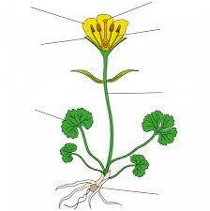
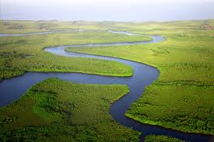
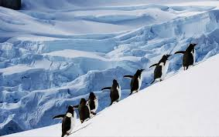
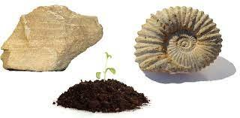
Science History and Geography
Term 1 – Light
Term 2 – Forces and Magnets
Term 3 – Rocks, Soils & Fossils
Term 4 – Animals including Humans (Healthy Eating)
Term 5 – Animals including Humans (Skeletons)
Term 6 – Plants
Term 1 – Rivers
Term 2 – Antarctica
Term 3 – Stone Age to Iron Age
Term 4 – Where does our food come from?
Term 5 & 6 – Ancient Civilisations and Ancient Egypt Study

Slide 16

The Curriculum
PE & Games
PE is taught twice a week and each lesson is an hour long. For this term, PE is taught on Wednesday and Thursday.
Kit
PE-T-shirt, shorts and plimsolls
Games – T-shirt, long-sleeved top, track suit bottoms (not leggings) and trainers
Long hair needs to be tied back and earrings either removed or taped.
The children wear their kit to school on PE days and will stay in the kit all day.

Slide 17
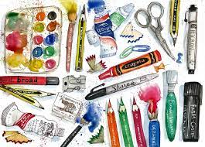


Other subjects
As well as the subjects already mentioned, children will continue to having lessons in: French, PSHE and Rights, Art, DT, Music and RE.
These lessons will be taught either consecutively each week or saved for a term which fits in with a wider school approach to a topic.

Slide 18
The beginning of the day
As per Mrs Fosters' recent letter, please refrain from parking in the school car park – this is for staff.
As per school directives, children are to be dropped off at the office and then walk down the corridor by themselves. This is for ensuring the safeguarding of all children.
If you need to speak to me, please email me at l.phillips@ladyj.kent.sch.uk to arrange a meeting and I will happy to meet with you.

Slide 19
Daily routine
An example of our day at school
8.35-8.55am | 9.00am | 9.15am | 10.10am | 10.25am | 12.00-1.00pm | 1.00pm | 2.00pm | 2.55-3.20pm
Early work | Celebration assembly | Times Tables Maths | Break | English & Reading Practice | Lunch | Geography | French | Story Time & Home Time

Slide 20
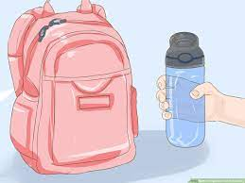
What your child should bring each day:
School bag, book bag and a water bottle
Lunch and a snack
Please name their belongings especially their uniform and PE and games kit.

Slide 21

Development and progress
Child development varies – every child has unique strengths and challenges.
We praise both talent and effort, focusing on hard work, determination, and resilience for lifelong success.
We’ll ensure every child gets the support they need to progress.
Key values like compassion, curiosity, resilience, collaboration, and aiming high will be recognised with certificates
Notes:
Sophie

Slide 22
Concerns re. Bullying:
Bullying is:
‘Behaviour by an individual or a group, repeated over time that intentionally hurts another individual either physically or emotionally.’
Children do fall out and need to learn to resolve differences (and it is our job to help them with this).
Bullying is rare at Lady Joanna (and we want to keep it that way)
However, if you have any concerns about bullying, please:
1. Speak to class teacher
2. If unresolved, ask to speak to Key Stage Lead (Rachael
Hollingworth KS1, Dennie Kemp KS2), then Deputy or Headteacher.
Your view as a parent is crucial. Sometimes children are reluctant to report bullying and need the support of parents/carers to do so.

Slide 23

Communication
In person – after school is easier than before. If possible, please wait until I have dismissed the class.
Emails – l.phillips@ladyj.kent.sch.uk
Please email – I will endeavour to respond to emails within 48 hours.
If something urgent crops up at the end of the day, please let the office know as I’m not usually checking emails.
Office Staff will send emails and texts with any key information.
Please remember to let office know if any of your contact details change throughout year.

Slide 24
How we will let you know how your child is doing?
We keep track of how your child is doing throughout the year in a variety of ways e.g. observations, marking, quizzes, etc.
Term 2: Parents’ Evening
Term 3/4: Mid Year Reports
Term 4: Parents’ evening
Terms 5 and 6: Final report and Open evening

Slide 25

How to help your child
Your child will receive homework, some of which is optional and some of which is essential. The essential homework follows on from what we are learning in class, this includes
- My Maths
- Spelling
- Reading
If your child is struggling with the homework, please just talk to us!
Occasionally, there may be additional homework to support with other lessons.

Slide 26

If you have any concerns, queries or questions, please just email me on L.Phillips@ladyj.kent.sch.uk

Slide 27
Reminders
Attendance and punctuality
Seating plans (thought-out and purposeful)
Reading books
Raincoat, waterproofs
Time to relax & sleep. Limit the use of screen time/internet access
Correct school uniform – child’s name and surname identified (PE Kit)
Phones! #smartphonefreechildhood

Slide 28
Volunteers
During the school year we will be needing your help with: reading with children, displays, admin, trips or even specialist skills you can offer.
In order to keep our children safe, the process of applying as a volunteer can take some time, so please start the process early if you can.
The more experiences we can give to your children the better their year will be, but we cannot do these activities without parent helpers.
Email k.weiss@ladyj.kent.sch.uk or see school website under Key Information/Policies/Volunteer Handbook if you think you can help.

