Slide 1


Slide 2
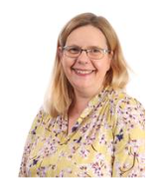
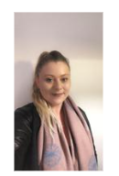
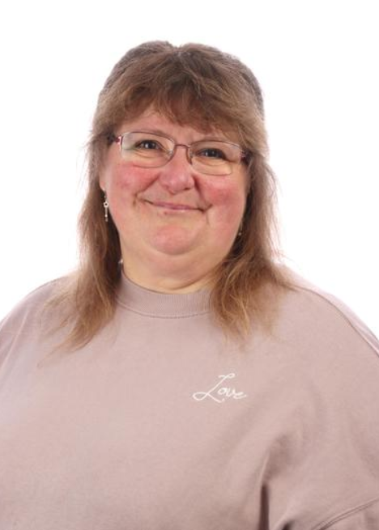

Adults working in Kingfisher Class
Mrs Boden – Class Teacher
Miss Farrin - TA
Mrs Miles - TA
Mrs Godden - TA

Slide 3
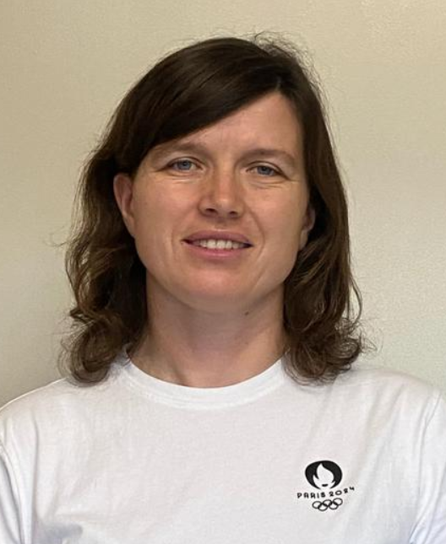
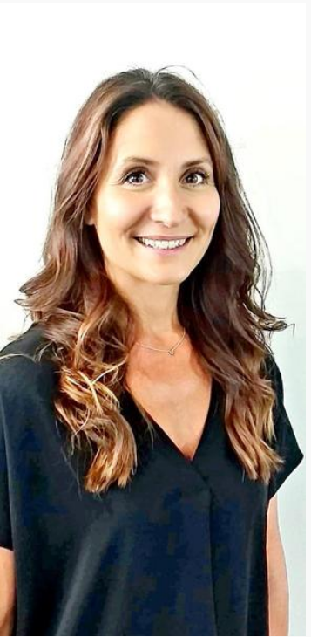
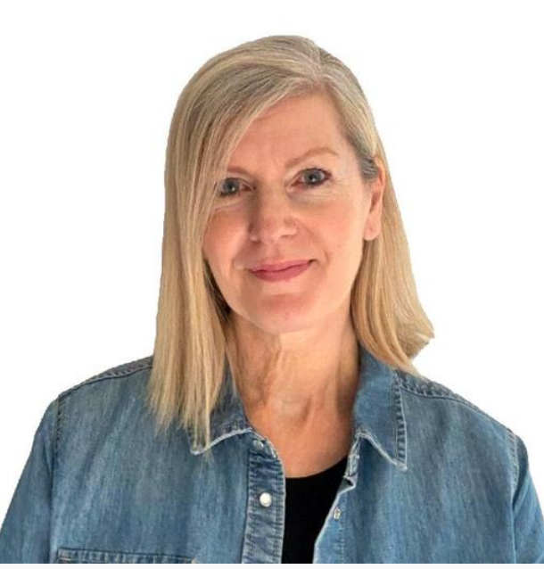
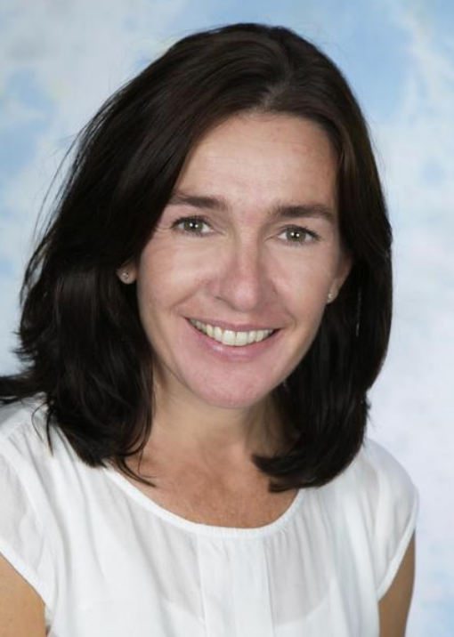
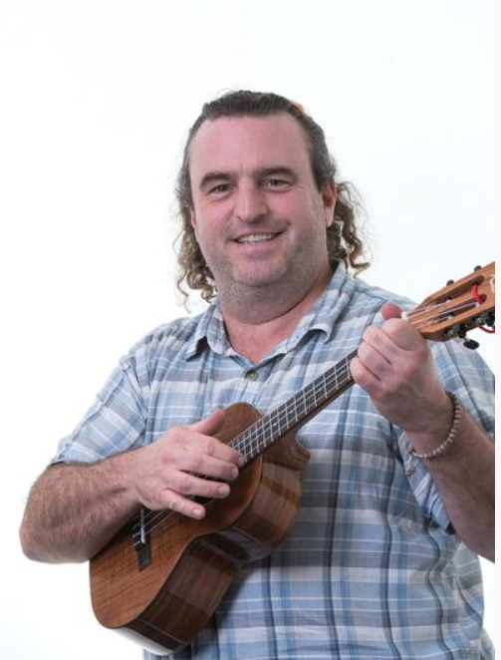
Adults who may work in Kingfisher Class
Miss Weller
HLTA
Mrs Roberts
HLTA
Mr Connelly
Music Teacher
Miss Fuller
PE Teacher
Mrs Selwood
HLTA

Slide 4
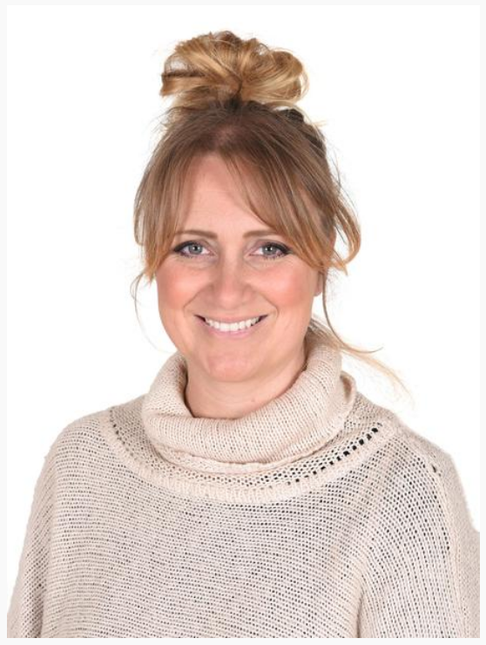
Phase Leader
Mrs Kemp

Slide 5
Lady J Legacy
At Lady Joanna Thornhill, we strive for the very best for our children, offering an education for the head, heart and hand that includes a wealth of opportunities and experiences to help develop our pupils and prepare them for their next steps in life.
As part of this we have developed the Lady Joanna Legacy. This is a series of opportunities and experiences that we pledge to ensure all children who attend Lady Joanna are able to access and enjoy during their time at school.
The Lady J Legacy in Year Four:
Learn to play a musical instrument (ukulele).
Engage in enterprise, creating and selling products.
Create artwork that is displayed in an exhibition or hung in a gallery.
Notes:
These activities aim to support the personal development of our children, readying them for life beyond primary school.

Slide 6
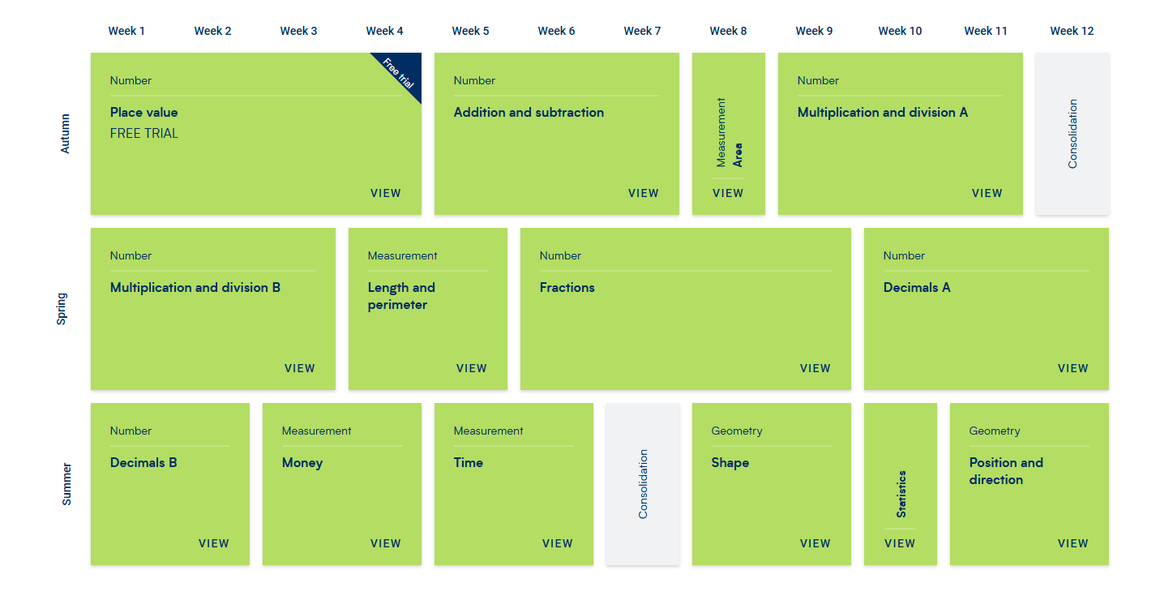
YR4 Maths Curriculum

Slide 7
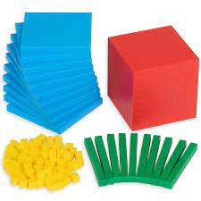
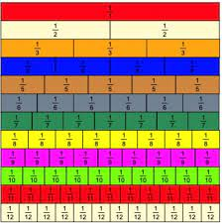
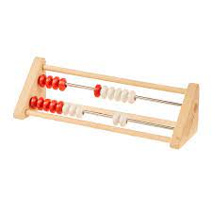
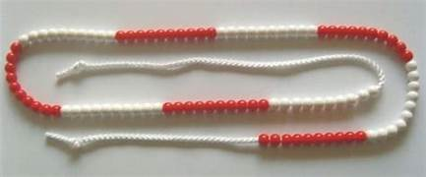
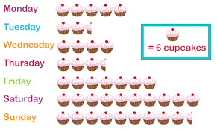
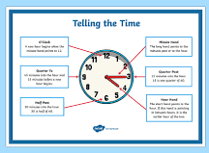
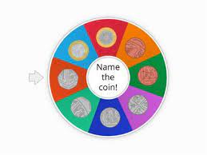
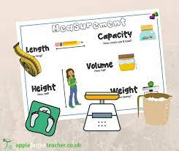
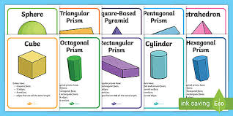
The Curriculum - Maths

Slide 8
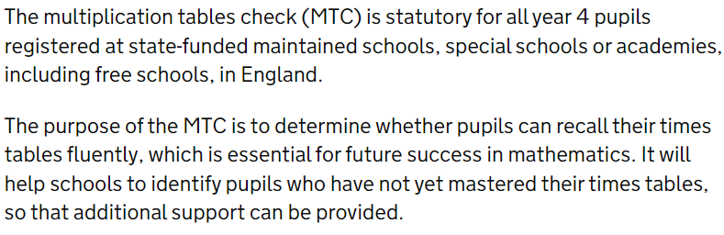
Multiplication check
Multiplication tables check - GOV.UK (www.gov.uk)

Slide 9
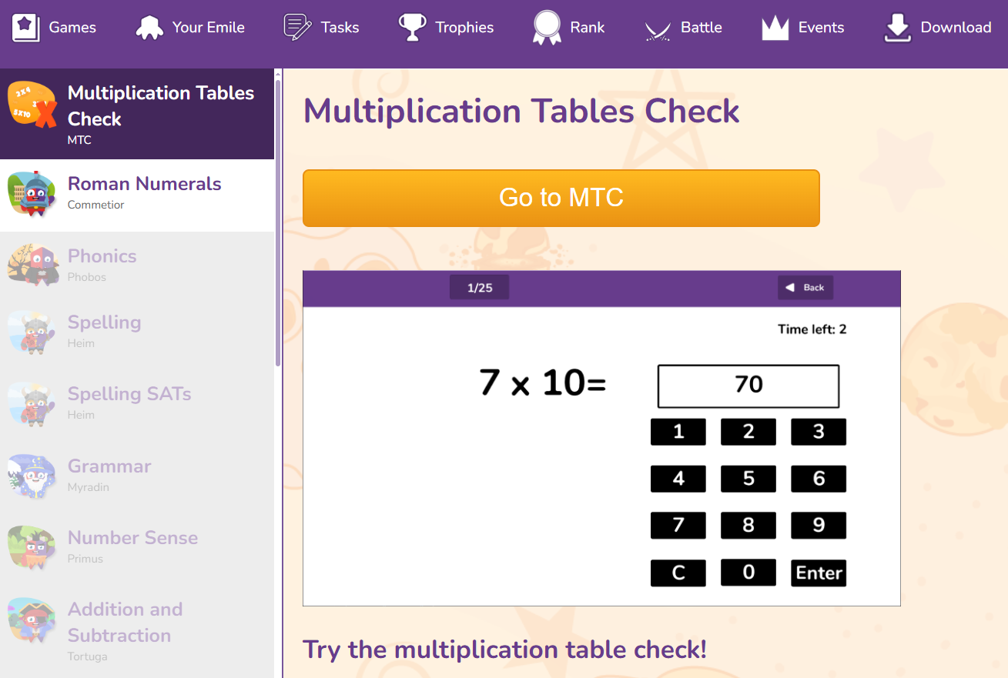
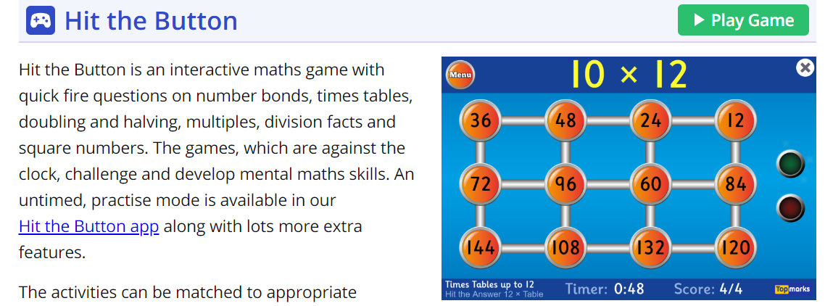
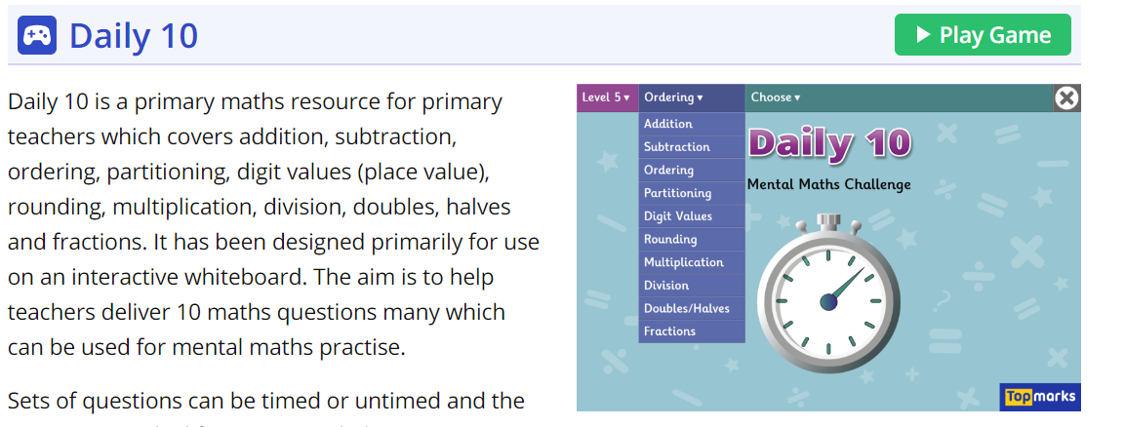
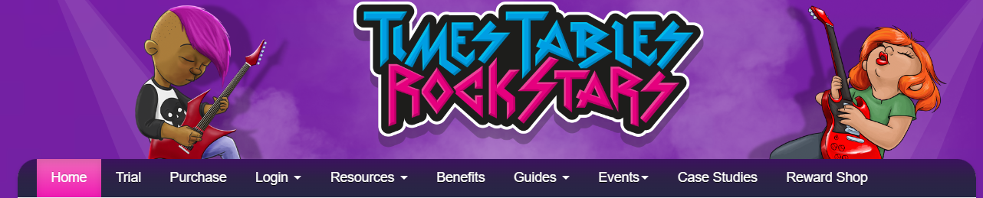
Emile Education – preparing for the MTC
Hit the Button - Quick fire maths practise for 6-11 year olds (topmarks.co.uk)
Daily 10 - Mental Maths Challenge - Topmarks

Slide 10



Key texts this year include…

Slide 11
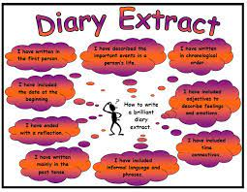
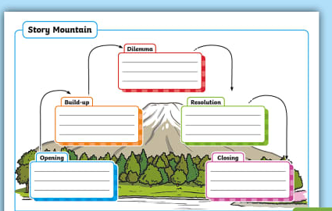


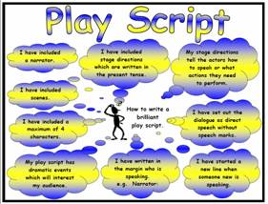
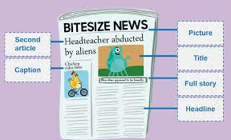

The Curriculum-English: Writing

Slide 12


Reading VIPERS

Slide 13

Accelerated Reader

Slide 14
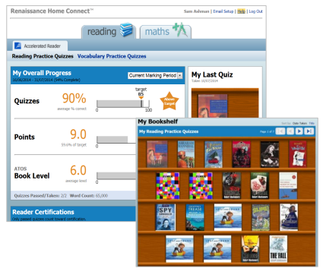
Home Connect
Parents, carers and grandparents track their children's reading from home using the website, Home Connect.
Add up to 6 email addresses and receive instant feedback on quiz results
The Bookshelf shows all books read and quizzed on by the child for Accelerated Reader.

Slide 15
How parents can register for Home Connect
Visit our website www.ladyj.kent.sch.uk
Click on ‘Parents' and Accelerated Reader Information'
Here you will find loads of information, all about Accelerated Reader.
Click on the link to Parents Home Connect https://global-zone61.renaissance-go.com/studentprogress/homeconnect?t=6707989
You will need to log on using your child’s username and password, which can be found in their Home Learning book.
Click on ‘Email Set Up’ in the top right of the screen.
Enter your name and email address (6 emails can be added)
You will receive a confirmation email from Home Connect and once you have accepted this, you will receive emails for quizzes and can log in to check your child’s progress towards their points target.

Slide 16
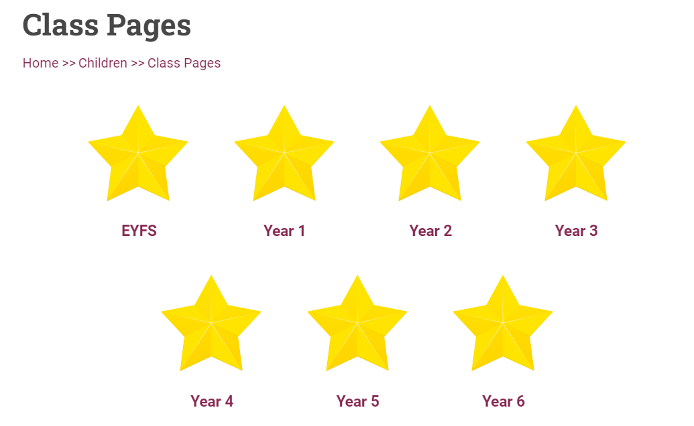
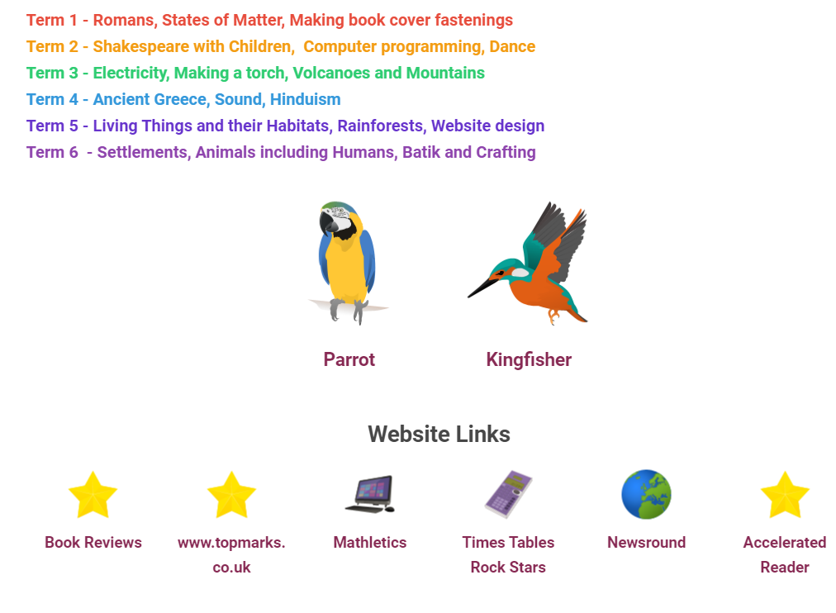
How Children can quiz…
Visit our website www.ladyj.kent.sch.uk
Go to Class Pages
Click on Year 4
Click on Accelerated Reader
Click on Take a Quiz
Login using your child’s username and password

Slide 17
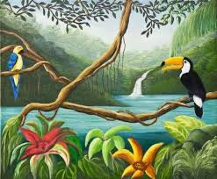
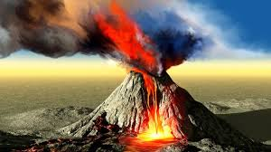
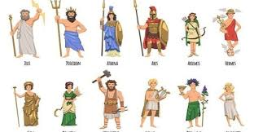
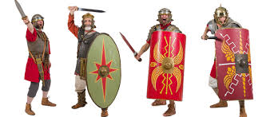
The Curriculum
Geography and History
Term 1 – Rainforests
Term 2 – Volcanoes and mountains
Term 3 and 4 – Romans
Term 5 – Settlements
Term 6 – Ancient Greeks

Slide 18

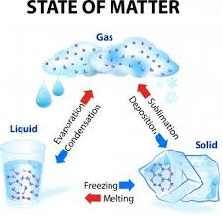
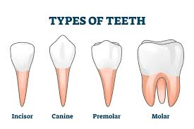
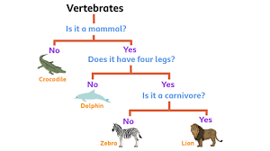

The Curriculum
Science
Terms 1 and 2 – Sound
Term 3 – States of Matter
Term 4 – Electricity
Term 5 – Animals including humans
Term 6 –Living things and their habitats

Slide 19
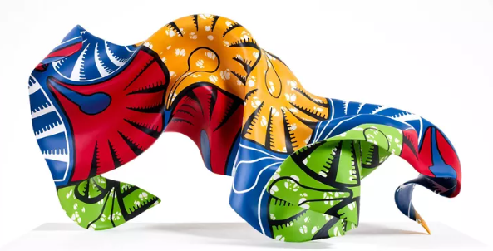
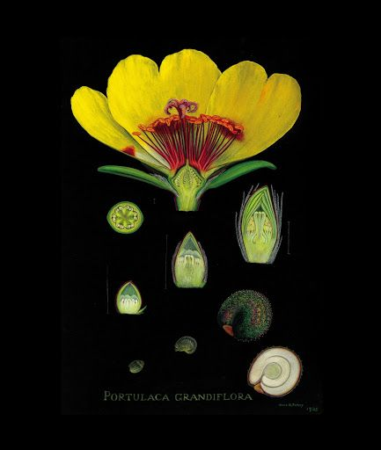
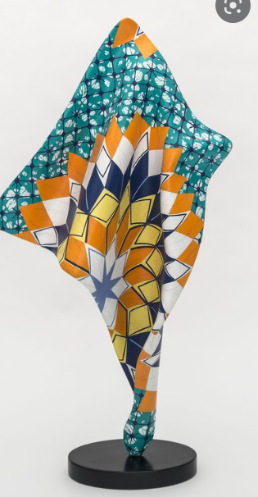
Art – Maud Purdy (American botanical artist)
Sculpture – Yinka Shonibare (British multi-disciplinary artist)

Slide 20
How to help your child
Daily reading and AR quizzing. Children will change their own book when they have completed a quiz.
Times tables – practise, practise, practise!
Weekly spellings
MyMaths homework
One other piece of homework per week from the homework grid.

Slide 21
Seating and grouping
Seating plan changes termly.
There are lots of opportunities to work with other children in group activities.

Slide 22
Communication
After school for a quick word
In person meetings to be arranged via email
URGENT messages to the Office
Other emails will get a response within 48 hours
Please remember to let office know if any of your contact details change throughout year.
Please communicate all absences to the office.

Slide 23
How we will let you know how your child is doing
We keep track of how your child is doing throughout the year in a variety of ways e.g. observations, marking, quizzes, etc.
Term 2 parents’ evening
Term 3 brief written report
Term 4 parents’ evening
Terms 5 and 6 – final report and Open evening

Slide 24
What your child should bring to school
PE kit to be worn to school Thursdays and Fridays
Water bottle
Raincoat and wellies
Names on all belongings

Slide 25
Volunteers
Need help with reading with children, displays, admin, trips, specialist skills you can offer
Email k.weiss@ladyj.kent.sch.uk or see school website under Key Information/Policies/Volunteer Handbook

Slide 26
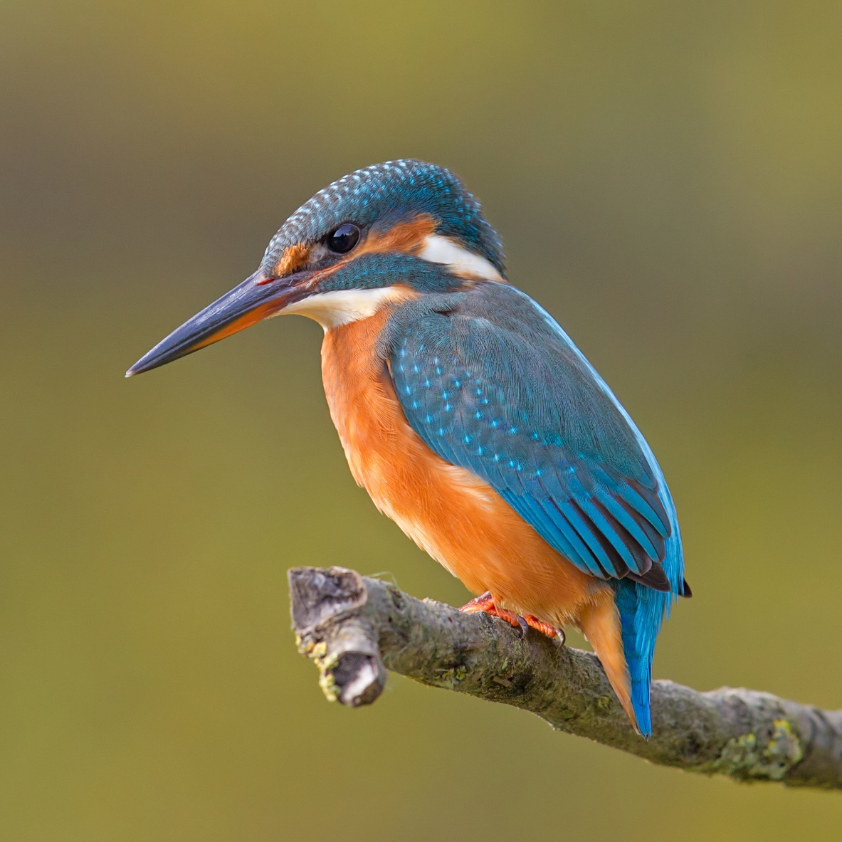
Thank you coming and have a lovely weekend!

