Slide 1
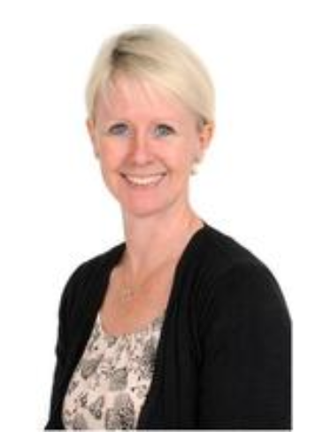
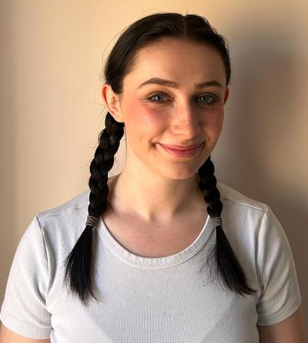
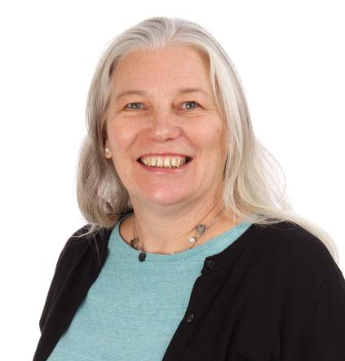
Welcome to
Year 2!
Miss Teesdale
Squirrel Class Teacher
Mrs Ward
Rabbit Class Teacher (Mondays and Tuesdays)
Miss Lewis
Rabbit Class Teacher (Wednesdays, Thursdays and Fridays)

Slide 2
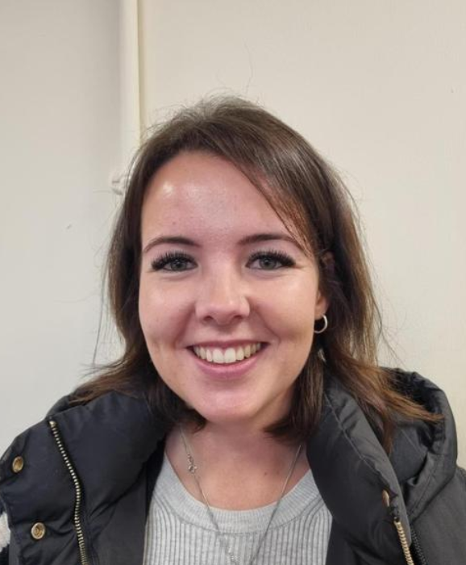
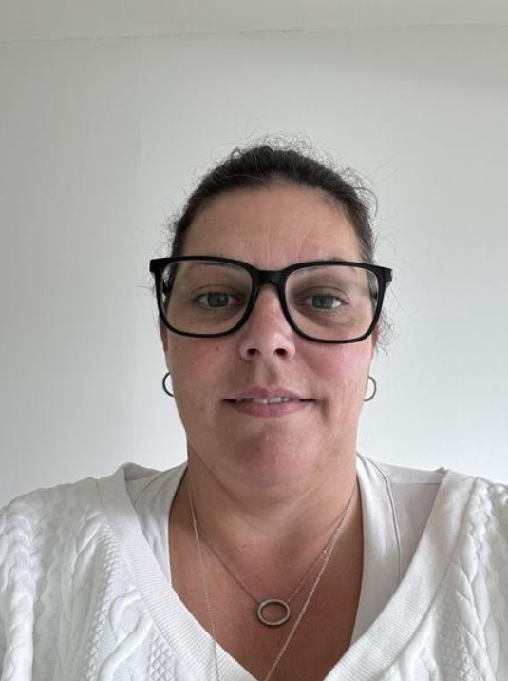
Other adults who will be supporting in Year 2:
Mrs West
Miss Livett

Slide 3
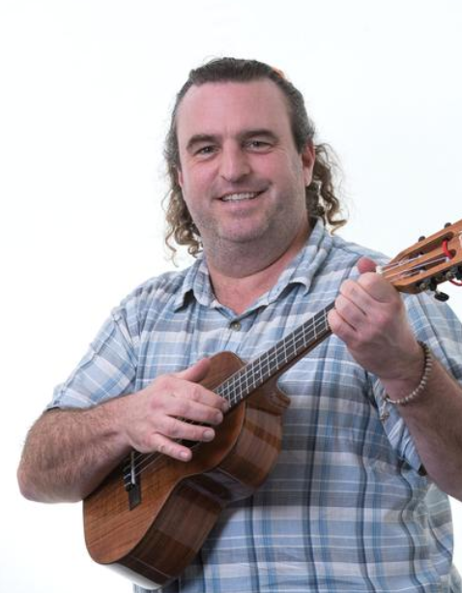
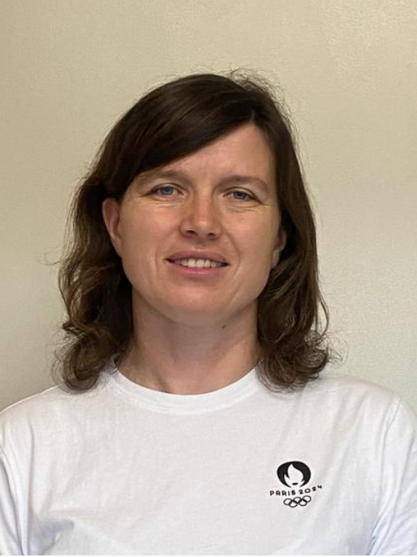
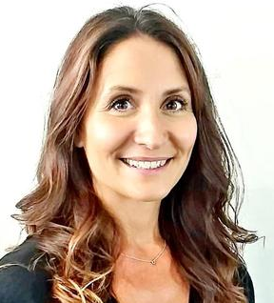
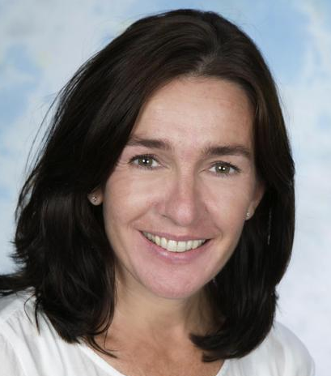
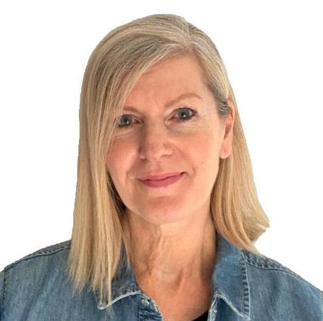
Other adults who will be teaching Year 2 sometimes:
Mrs Roberts
HLTA
Miss Fuller
PE Teacher
Mrs Selwood
Dance Teacher
Miss Weller
HLTA
Mr Connolly
Music Teacher
Sports Coaches from Venture will also be teaching some PE sessions.

Slide 4

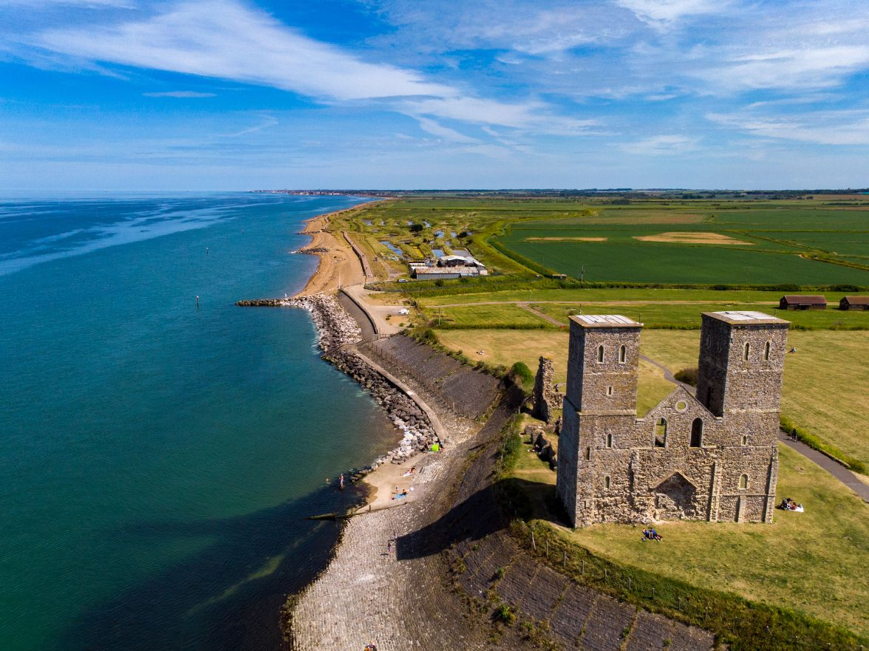
Highlights of the year
The Nativity
Coastal Study of Reculver (Term 5)
Rainforests
Class assembly

Slide 5
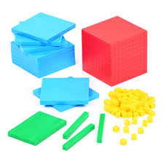
The Curriculum
Maths
At Lady J, we encompass all three key areas of maths mastery: fluency, reasoning and problem solving. The aim is for the children to build resilience, develop a greater sense of number, confidently articulate their thinking and connect maths to the real world.
The lessons structures vary but usually follow a “ping-pong” approach whereby the learning is broken into segments including teaching and modelling, exploration, discussions, assessment, group practice and independent practice. This way of teaching allows all children to be challenged at a level appropriate to them.
Notes:
Talk about the benefits of practical lessons and why we have moved away from the traditional format of input – independent work – plenary.

Slide 6

The Curriculum
Reading
We will start the year revising some of the phonic content from Year One. This will allow the children to consolidate their learning and we will also provide extra challenge with a focus on applying phonics for spelling. Children will read in small groups each week with a grown up, progressing their reading level as they go. Children will continue using the Little Wandle reading books until their phonics is secure, at which point they will move onto Fluency books.
We listen to the children read at least three times a week in a group. Children will take home a reading book based at their level, plus a 'reading for pleasure’ book each week. Please ensure you hear your child reads and record it in their reading record. These are to be returned every Monday.

Slide 7

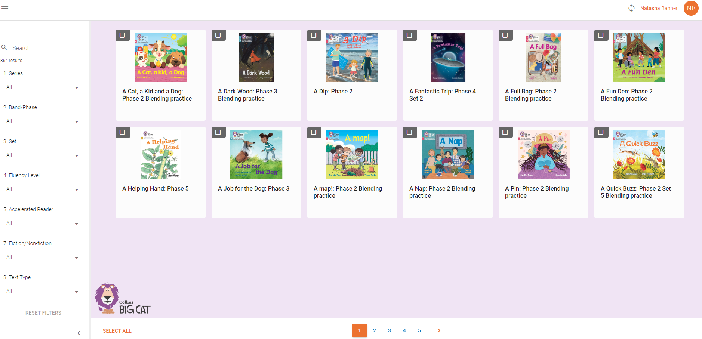

Slide 8


Slide 9

We have been overwhelmed by your generous response to our 50 Books to Read Before You Leave Year 2 project.
There are still lots of book choices available should you wish to donate!

Slide 10

The Curriculum
Writing
Naturally, some of the writing we do will be linked to our topics (next slide). We will also be doing whole units of writing on the following texts:
The Gigantic Turnip
Owl Babies
The Princess and the Pea
George and the Dragon
There's a Rang-Tan in my Bedroom

Slide 11
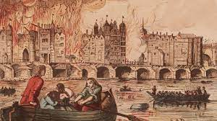
The Curriculum
Geography and History
Term 1 – Would you prefer to live in a hot or cold place?
Term 2 – The Great Fire of London
Term 3 – Why is our world wonderful?
Term 4 – Explorers
Term 5 – What is it like to live by the coast?
Term 6 – Aviators

Slide 12
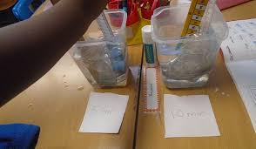
The Curriculum
Science
A passion to understand and to find out more about the world underpins our teaching of Science at Lady Joanna and is what we aim to inspire within our children. Our broad, rich Science curriculum not only provides children with the key scientific facts and concepts, but also gives them plentiful opportunities to be able to hone their practical and problem solving skills through hands-on investigations and enquiry-based learning. Children learn to work independently and in collaboration with others, growing in confidence and resilience and, most importantly of all, with a sense of wonder and curiosity about the world around them.
The topics we will cover in Science this year are:
Materials
Animals including humans
Living things and their habitats
Plants

Slide 13





The Curriculum
Other subjects
The children will also have lessons in:
Art/Design Technology
PE (at least two sessions per week)
PSHE
RE
Music
French
Computing

Slide 14

Lady Joanna Legacy
Experiences from Year 2 include:
Observe and record the lifecycle of an insect or animal.
Grow and eat their own vegetables.
Speak to a policeman, paramedic, nurse, firefighter about their role and responsibilities within the community.
Visit a farm and learn about agriculture and animals.

Slide 15
Communication
In person – after school easier except on meeting days, before school for emergency.
Email and text via Teachers2Parents.
Our emails are on the newsletter.
Please remember to let office know if any of your contact details change throughout year.
If your child will be absent or will be in late/leaving early, please let the office know via the absence email (also on the newsletter).
We will attempt to answer emails within 48 hours – not including holidays and weekends.

Slide 16
How to help your child
Daily reading.
MyMaths homework – logins pending.
One other piece of homework per week from the homework grid, which will be sent home next week.

Slide 17
How we will let you know how your child is doing
We keep track of how your child is doing throughout the year in a variety of ways e.g. observations, marking, quizzes, etc.
Term 2 parent consultations
Term 3 brief written report
Term 4 parent consultations
Terms 5 and 6 – final report and Open Evening

Slide 18
What your child should bring each day
Healthy snack (no nuts please)
Water bottle
Book bag
PE kit to be kept in school
Hat and sun cream when weather is hot
Coat when weather is cooler

Slide 19
Volunteers
We need help with reading with children, trips, talks, workshops etc. If you are a keen helper, or have specialist skills you can offer, please contact Mrs Weiss – we’d love to have you!
Email k.weiss@ladyj.kent.sch.uk or see school website under Key Information/Policies/Volunteer Handbook.
All volunteers will need to be DBS checked.

Slide 20
Some gentle reminders
Please do not park in the staff car park unless you have been given specific permission – inluding during Thrive hours.
Following this week, once the children feel settled with coming into the school, could parents not come into the cloakrooms unless absolutely necessary.
Please bring everything in on a Monday: reading books, reading records, home learning books (homework books to be sent home Wednesday, reading books to be sent home Friday)

Slide 21
We are really excited to be working with your children this year!
Please do not hesitate to contact us with any concerns at all.
Any questions?

