Slide 1


Welcome back!

Slide 2

...learned, taught, practised, respected, protected and promoted.

Slide 3

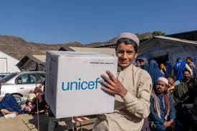
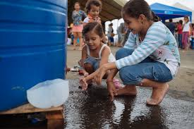
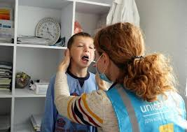
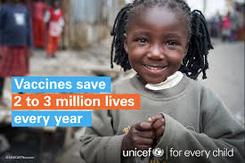
UNICEF was established in 1946 to provide emergency food and healthcare to children in countries that had been devastated by World War II. Since then, they have fought to protect the rights and well-being of every child in the world.
Notes:
Vaccines
Clean water
Education
The UN Convention of the Rights of the Child is a written agreement of the basic rights of all children and it has been signed by 196 countries. This forms the basis of all of UNICEF’s work.

Slide 4
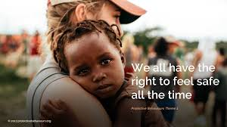
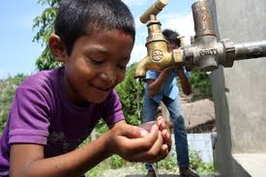
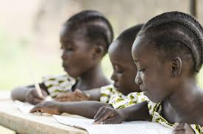
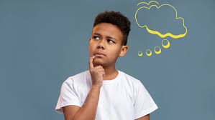
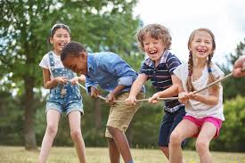
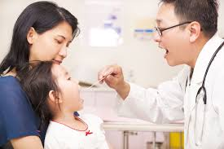


But, what are rights?
Your rights are the basic things you need and should have. Nobody should be able to take your rights away from you.

Slide 5
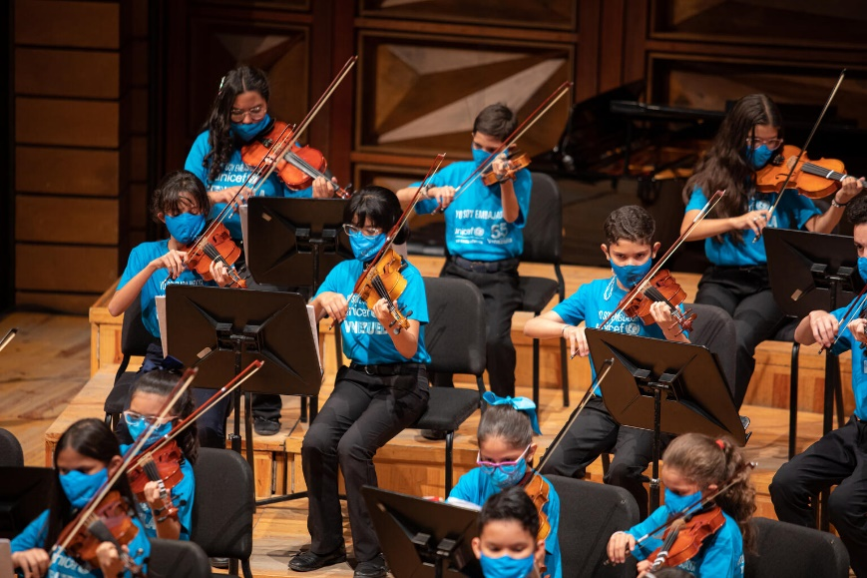
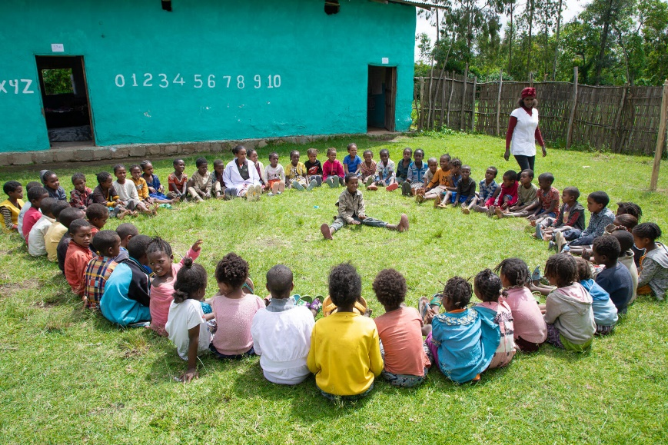
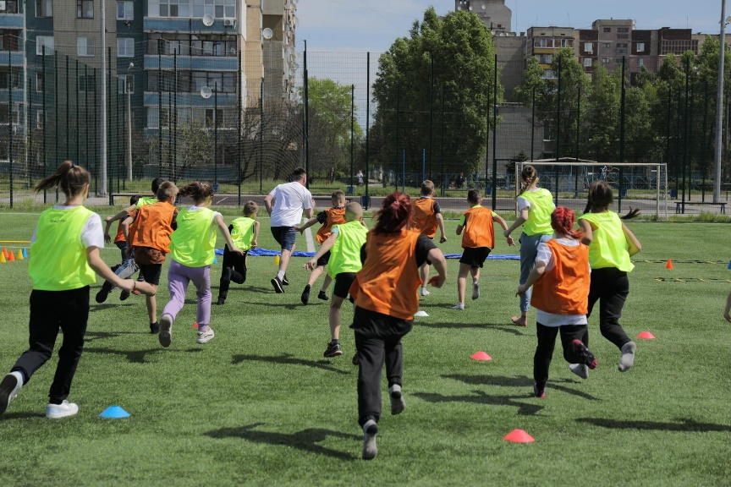
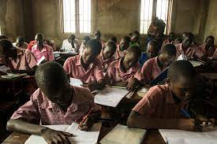
GUESS THE ARTICLES

Slide 6

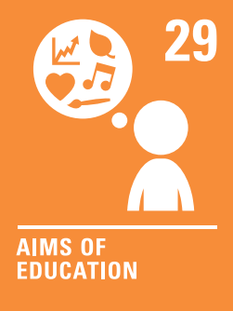
Article 28– Every child has the right to an education.
Article 29 – Education must develop every child’s personality, talents and abilities to the full. It must encourage the child’s respect for human rights, as well as respect for their parents, their own and other cultures, and the environment.

Slide 7
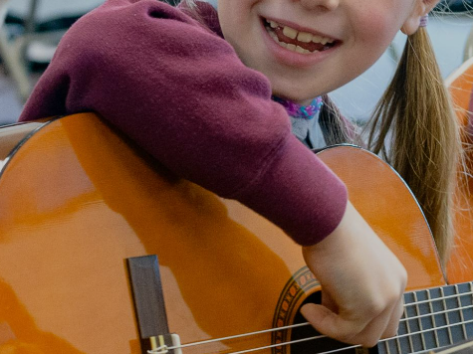
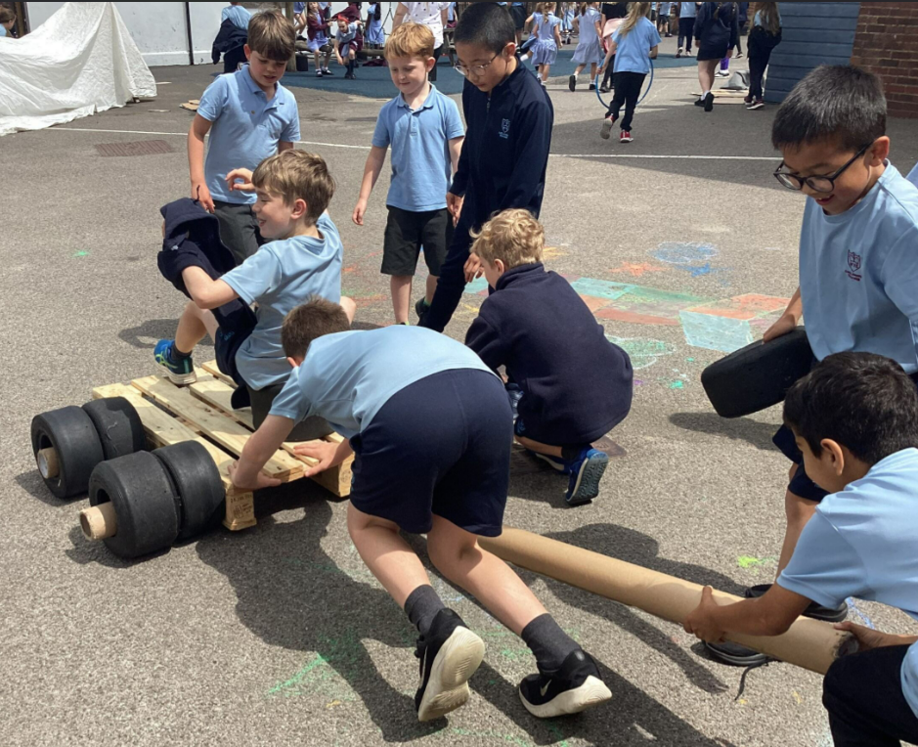
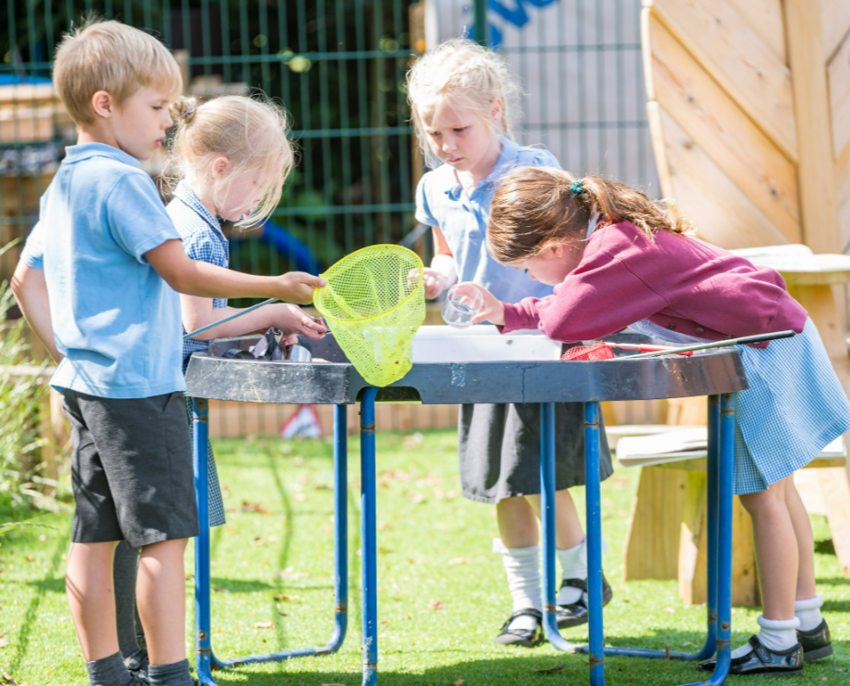
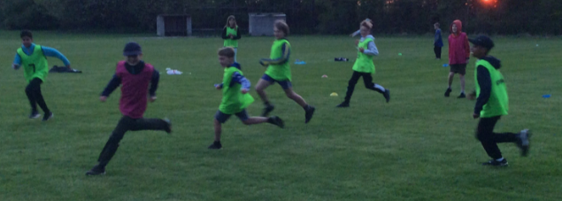
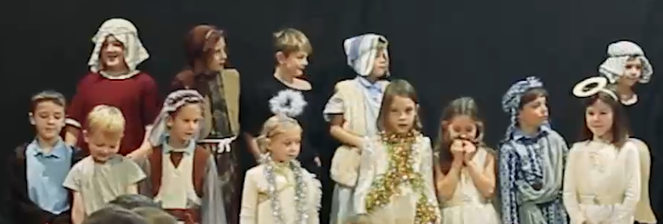
EXPLORING ARTICLE 29
How can education support you to develop your personality, talents and abilities?

Slide 8
EXPLORING ARTICLE 29
Did you think of these?
Support health and wellbeing
Understanding human rights
Provide a safe space
Treating you as an individual
Learning about different careers
Providing access to music, art and sports
Giving you a voice
Encourage friendships
Trips / Residentials
Productions
Outdoor learning
Clubs
OPAL
What else did you think of?
Notes:
opal

Slide 9


Slide 10
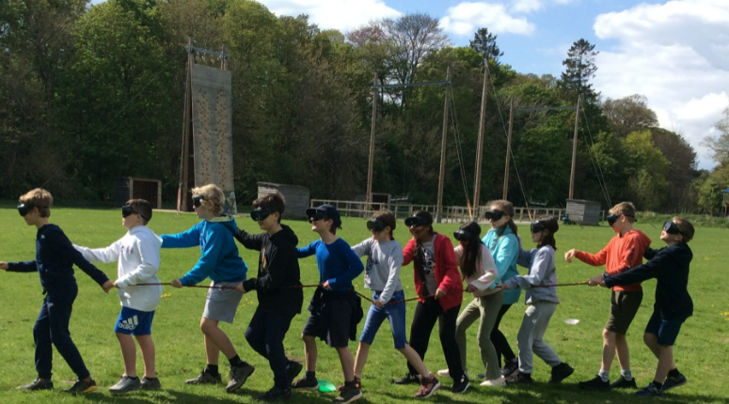
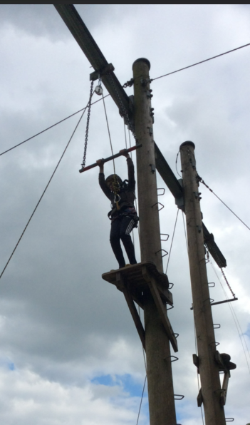
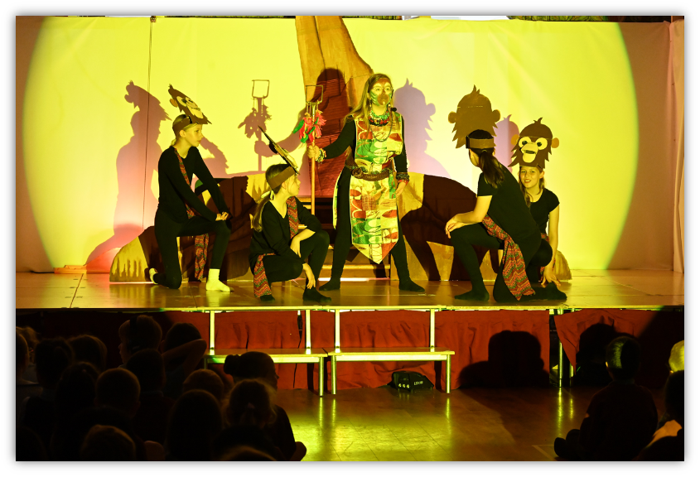
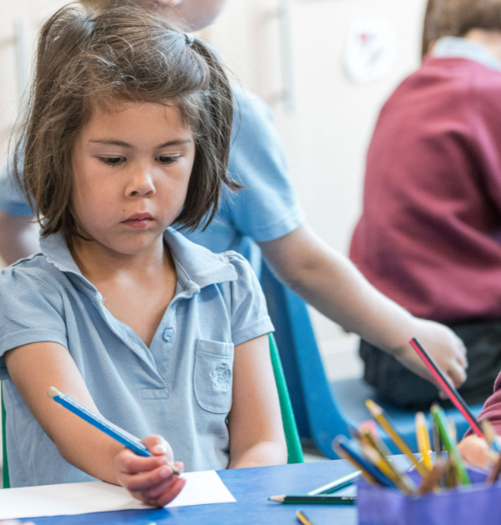
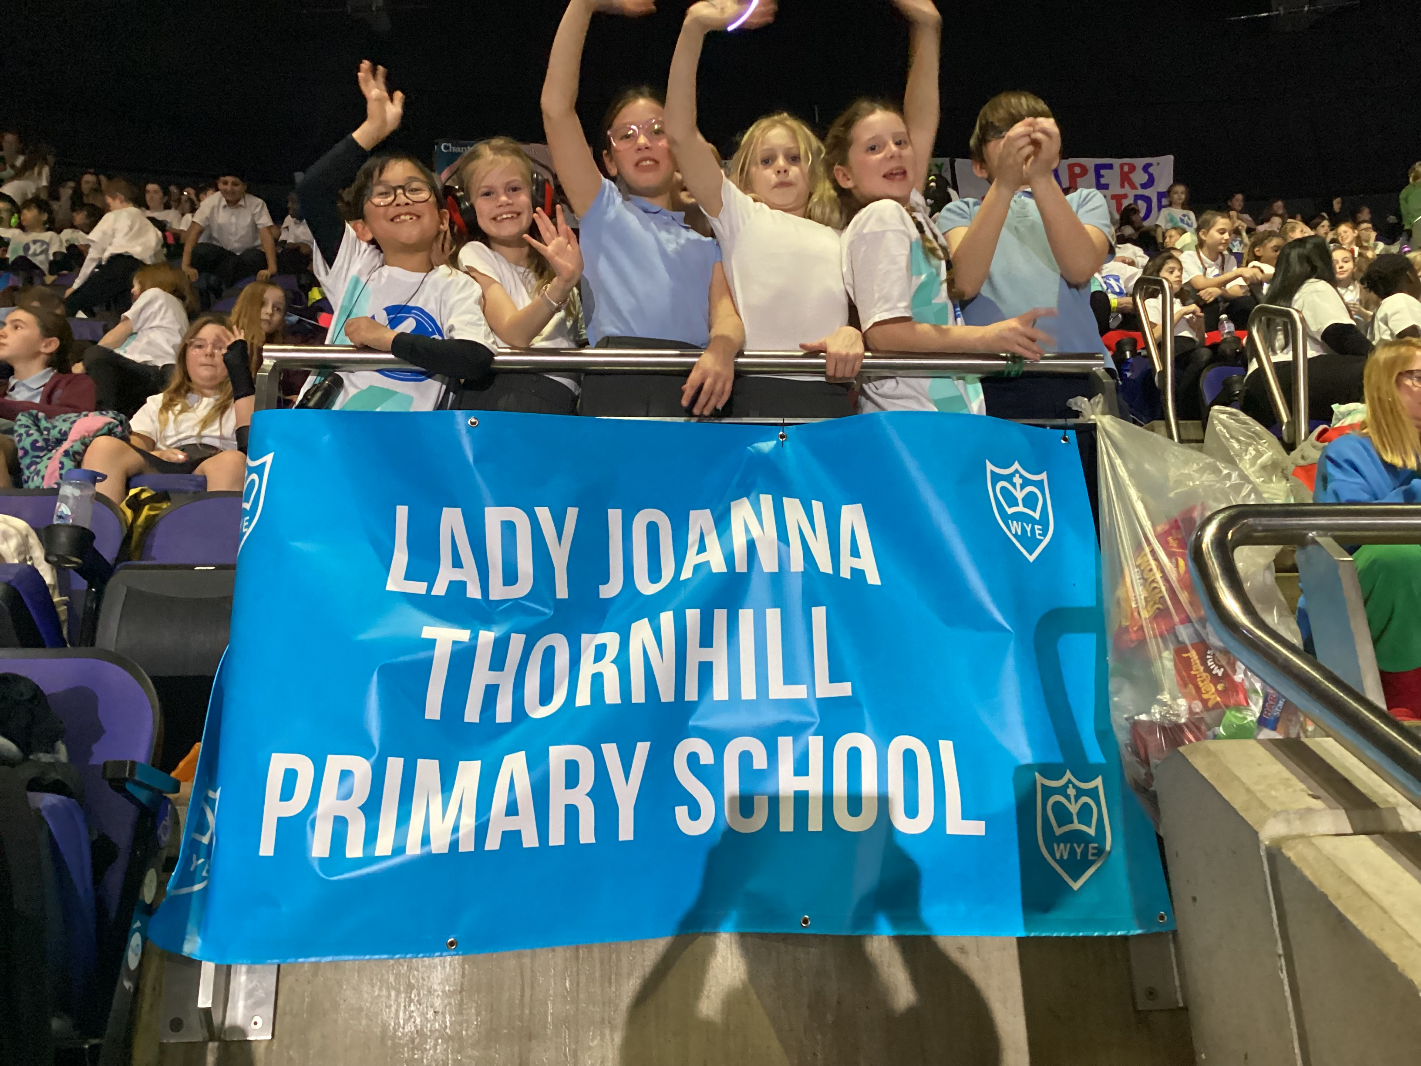
What skills will you learn this year?
What talents will you develop?
How will you make the most of the opportunities provided to you?

