Slide 1


Slide 2

School Council

Slide 3
What is a School Council?
A School Council is a group of pupils within a school who are elected by their peers to represent them and their views.
They collect the ideas of their classes and bring these ideas for discussion at meetings of the School Council.
The School Council will meet every two weeks with Mrs Kwouk and Mrs Boden to discuss these ideas and decide what actions we are going to take.

Slide 4
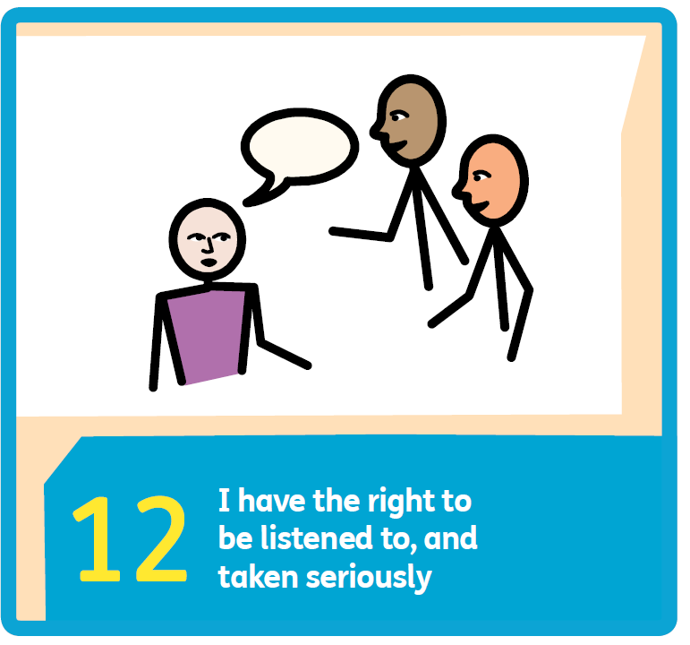
Why have a School Council?
Article 12 of the United Nations Convention on the Rights of the Child (UNCRC) says that every child has the right to express their views, feelings and wishes in all matters affecting them, and to have their views considered and taken seriously.

Slide 5
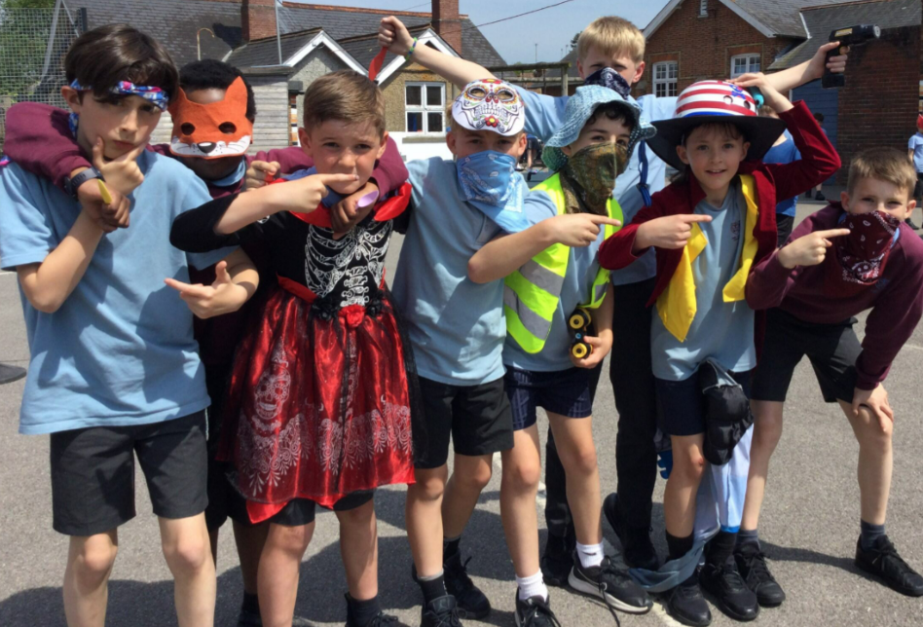

What does the School Council discuss and make decisions about?
OPAL
Clubs
Environmental issues
How we can support charities
Improvements to our school environment
And lots of other issues!

Slide 6
Who is in the School Council?
You will get the chance to elect two representatives per class; one boy and one girl.
Anyone who hasn't been in the School Council before can put themselves forward and stand up in front of their class to explain why they should be chosen.

Slide 7
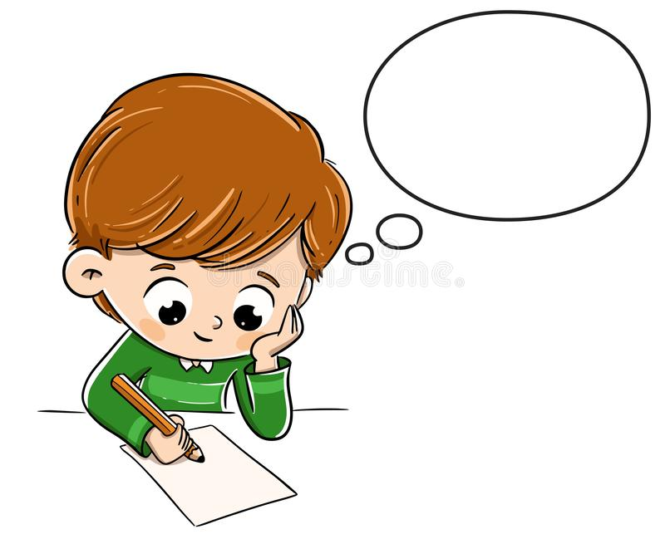
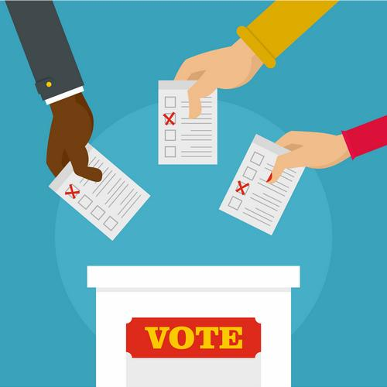

When will we do our votes and elections?
If you wish to stand for School Council, you need to write a short speech about why you should be elected that you will deliver to your class on Monday 16th September (next week).
Monday 16th September (Week 3)- Speeches delivered in class. Afterwards, the children in each class vote anonymously for one boy and one girl in their class.
The new school councillors will be announced in assembly on Wednesday 18th September.
The first meeting of the School Council will take place on Friday 20th September during assembly time.

Slide 8
What makes a good School Councillor?
Being a School Councillor is a serious commitment so think hard about whether you have what it takes. The qualities you will need include:
Being passionate about making a difference to the school and the wider community.
Being committed to attending regular meetings. Reliability and punctuality are essential!
Fully embracing our school rules and values.
Understanding and being committed to promoting the rights of all children.

Slide 9
Questions
If you have any questions about the School Council or you would like to find out more information before deciding whether to stand for election, please speak to your class teacher, Mrs Kwouk or Mrs Boden who will be pleased to help you.

