Slide 1

Children must be treated with:
Dignity
Equality
Respect
Notes:
The UN Convention on the Rights of the Child (a document outlining the rights of all children) says that children must be treated with Dignity, Equality and Respect). We are looking at the concept of dignity. Ask the children if they can tell you what dignity means.

Slide 2
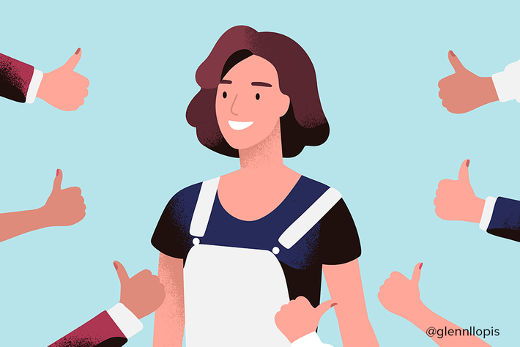
DIGNITY: The importance and value that a person has, that makes other people respect them or makes them respect themselves.
Notes:
The value that you all have that make other people respect you or you respect yourselves.

Slide 3
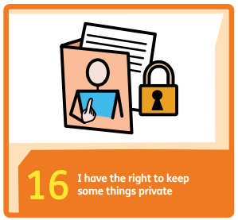
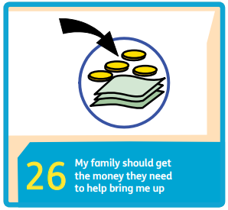
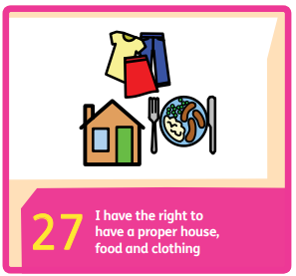
If these rights were not followed, how would this affect a person’s dignity?
Notes:
Rights help to protect dignity of everyone.
16 – not everyone needs to know everything about you. Respect that some things are private. If didn’t have privacy, would be embarrassed – affects dignity.
26 and 27 – may not have good clothes, decent place to live – may affect self-esteem, pride and dignity.

Slide 4

Notes:
Why were some people invisible?
Were the invisible people perceived as important as the people who could be seen?
In this story, the invisible people are people in society who perhaps are sometimes overlooked and ignored. They are people who are not respected or valued and therefore are not treated with dignity.
The message is that everyone has a place in this world and everyone can make a positive difference to the world.

Slide 5
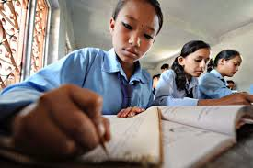
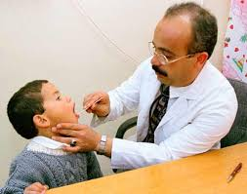


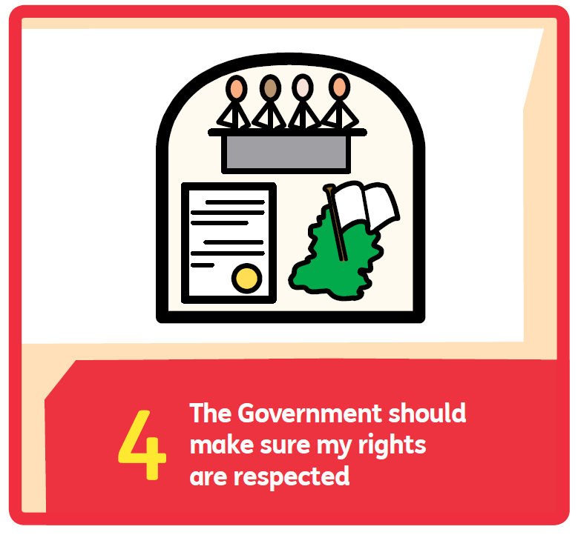
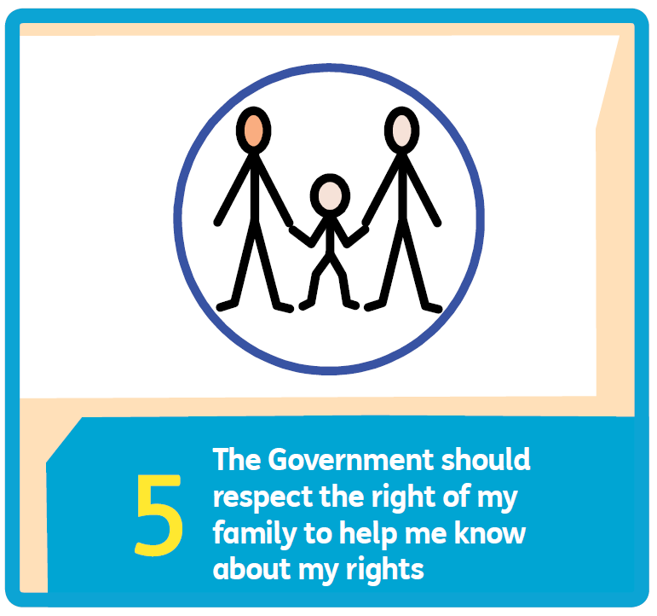
What does the government do to protect your dignity?
Notes:
Discuss free education and healthcare for all, benefits and FSM for those families on lower incomes etc. Children might be able to think of more. Talk about how these things are children’s rights and mention articles 4 and 5 which are about making sure their rights are respected.

Slide 6
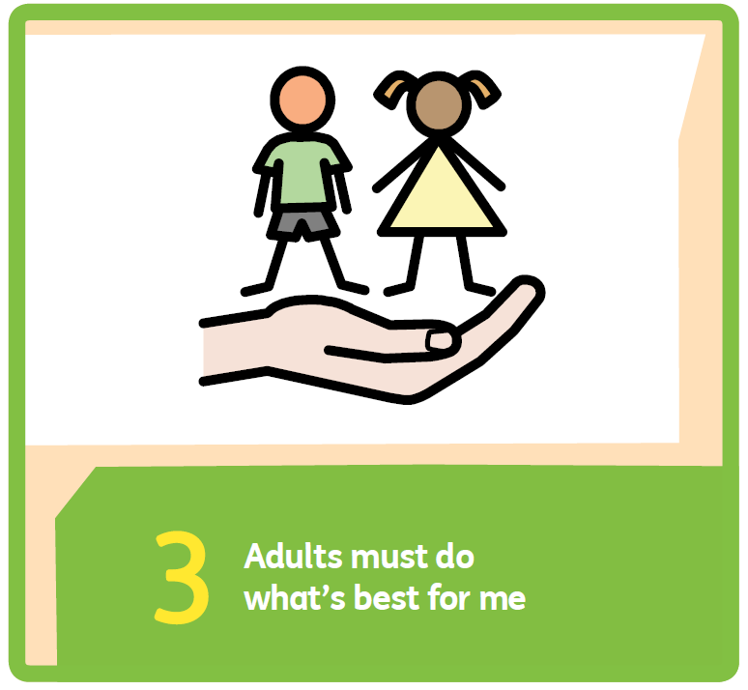
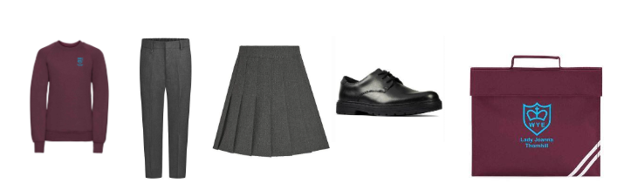
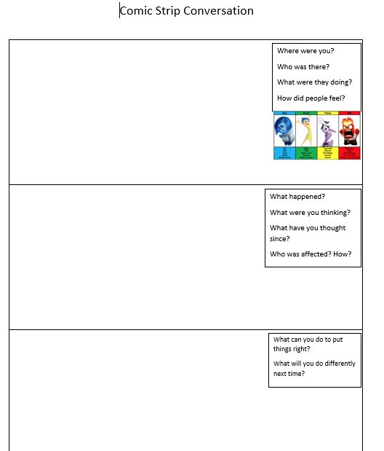
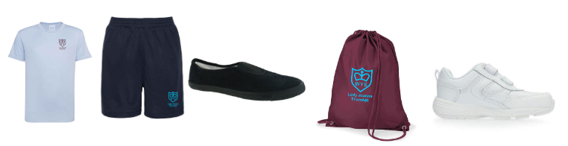
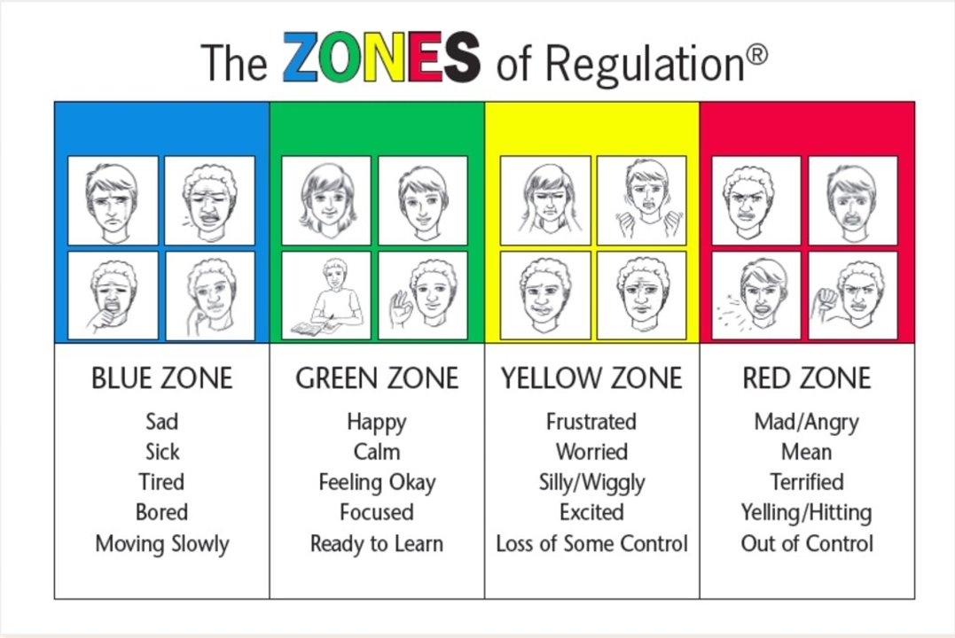
How is your dignity protected at Lady J?
School Council
Year 6 Ambassadors
Notes:
Show slide and ask children if they can suggest how children’s dignity is protected at Lady J. The school uniform - nobody can be judged on what they are wearing and can’t be made to feel bad if they don’t have designer clothing.
Comic strip conversation – incidents are dealt with discreetly away from other children.

Slide 7
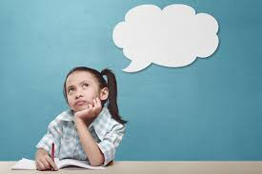
How can you make sure you treat other children with dignity?
Notes:
Take suggestions from children.

Slide 8
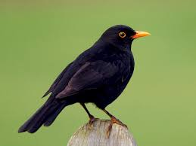
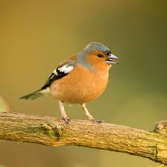
And the new school councillors are...
Blackbird Class
LOUIS
LEAH
Chaffinch Class
STIRLING
ERIN

Slide 9
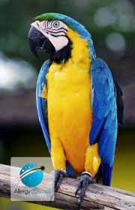
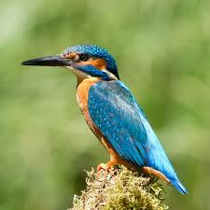
And the new school councillors are...
Parrot Class
MATIN
MIRA
Kingfisher Class
HELENA
HARRY

Slide 10
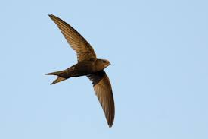
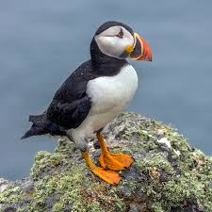
And the new school councillors are...
Swift Class
Puffin Class

Slide 11
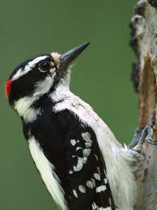
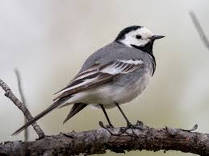
And the new school councillors are...
Woodpecker Class
Wagtail Class
BROOKES
AVA

