Slide 1
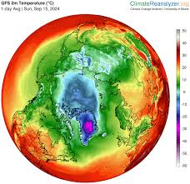
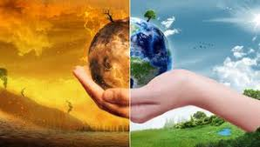
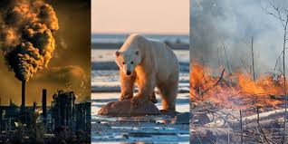
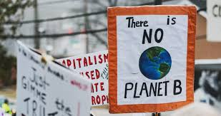
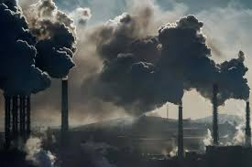
Notes:
Would anyone like to guess what today’s assembly will be about?

Slide 2
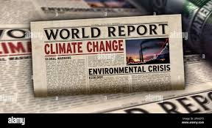
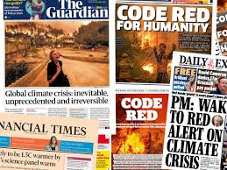
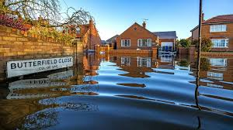
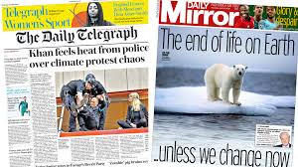
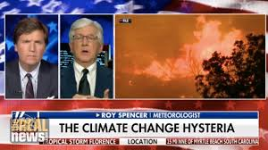
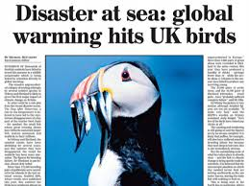
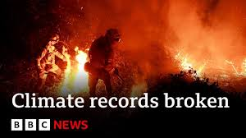
Notes:
Climate change is a big deal. It is talked about in the news a lot and it is something that politicians and world leaders all around the world discuss every single day. You may hear your parents or other adults talking about it and it’s something we talk about at school a lot too.

Slide 3
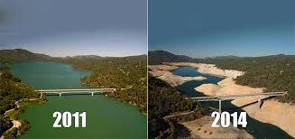
What is climate change?
The change in weather conditions over a long period of time.
Scientists have been monitoring and recording the temperature for hundreds of years and have noticed the earth is getting warmer.
Lake Oroville, CA
Notes:
Well, the word ‘climate’ means the weather conditions over a long period of time and we know that these weather conditions are changing quite dramatically.
The word climate means the long-term weather conditions in an area.
Since the 18th century, scientists who study weather (known as meteorologists) have been recording the weather and temperature. These records show that the world is getting warmer. The picture shows an area suffering from one consequence of climate change – drought. You can see here a really clear consequence of climate change – the picture on the left shows what this lake in USA looked like in 2011 and the picture on the right shows the same lake 3 years later with clearly a lot less water in it. We’ll talk a bit more about consequences like this in a bit.

Slide 4
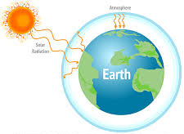
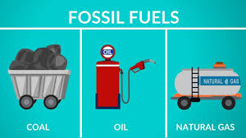
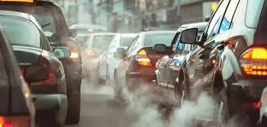
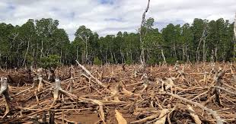
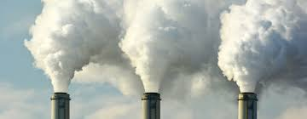
Why is the earth getting warmer?
Human activity causes gases, like carbon dioxide, to be released into the Earth’s atmosphere. These gases then act like a blanket wrapped around the Earth, trapping heat in.
Notes:
A lot of what we do or what we use every day involves burning fossil fuels. Fossil fuels are coal, oil and gas. When fossil fuels are burned, they release gases such as carbon dioxide into the earth’s atmosphere. These gases act like a blanket by trapping in the heat from the sun and this is why the earth is getting warmer.
Examples of things that we do that cause carbon dioxide to be released include using cars, manufacturing things in a factory and also deforestation. Trees are excellent for the planet because they store carbon dioxide and stop it being released into the atmosphere but when they are cut down, the carbon dioxide is then released. A lot of the electricity we use is generated by burning fossil fuels and most homes are heated by burning fossil fuels.
Transport – cars, buses, trains, trucks, ships and planes, (unless electric and charged with renewable energy), all produce emissions by burning fossil fuels.

Slide 5
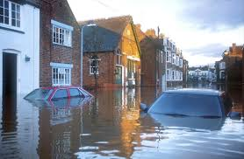
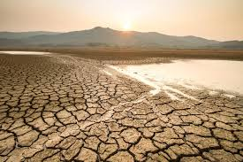
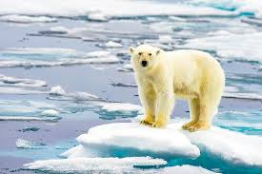
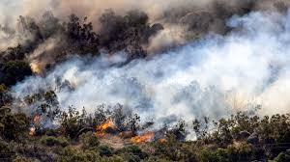
Why is climate change such a big problem?
Flooding
Droughts
Melting ice caps
Forest fires
Notes:
Climate change causes severe weather which causes problems, e.g. the rising temperature of the earth is causing the ice caps to melt. This means the sea levels are rising and it’s a big problem for animals like polar bears and walruses who need the ice to hunt and to survive. Climate change also means that some places are experiencing drought which means there isn’t enough rain and so crops and animals cannot survive and this can mean people can find it difficult to get enough food to eat. The opposite problem is of course flooding when there is too much rain.. This picture was actually taken in the UK, in this country and as climate change continues to get worse, we are seeing more and more floods like this. Floods don’t just cause lots of damage to houses and cars, but they also present a danger to the people living in these areas. Forest fires are something else that can happen as a result of the earth getting warmer.

Slide 6
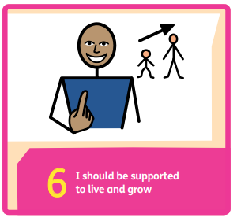
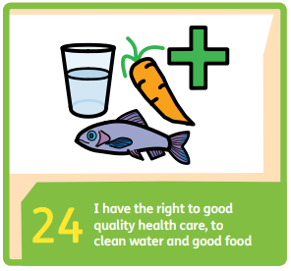
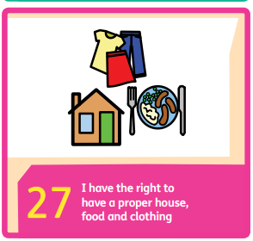
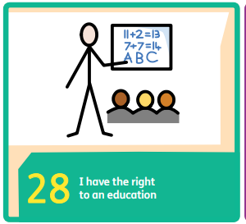
What has climate change got to do with children’s rights?
Notes:
This is a rights assembly and you may well be wondering what climate change has to do with children’s rights. Well the answer is it has a lot to do with children’s rights. Would anyone like to suggest how climate change can affect our rights? I’ve put up here just some of the rights that are relevant. Article 6 is about the right to life. As we’ve discussed droughts and floods can be really serious and sadly not everyone always survives them. We know that droughts can mean that crops can die out and families can struggle to get enough food to eat. Flooding can damage houses and mean that families are forced to leave their homes. If the roads are flooded, this can mean people cannot get to doctors or hospitals or even school and if children can’t get to school, their right to education is massively affected.
6: Every child has the right to life. Governments must do all they can to ensure that children survive and develop to their full potential.

Slide 7
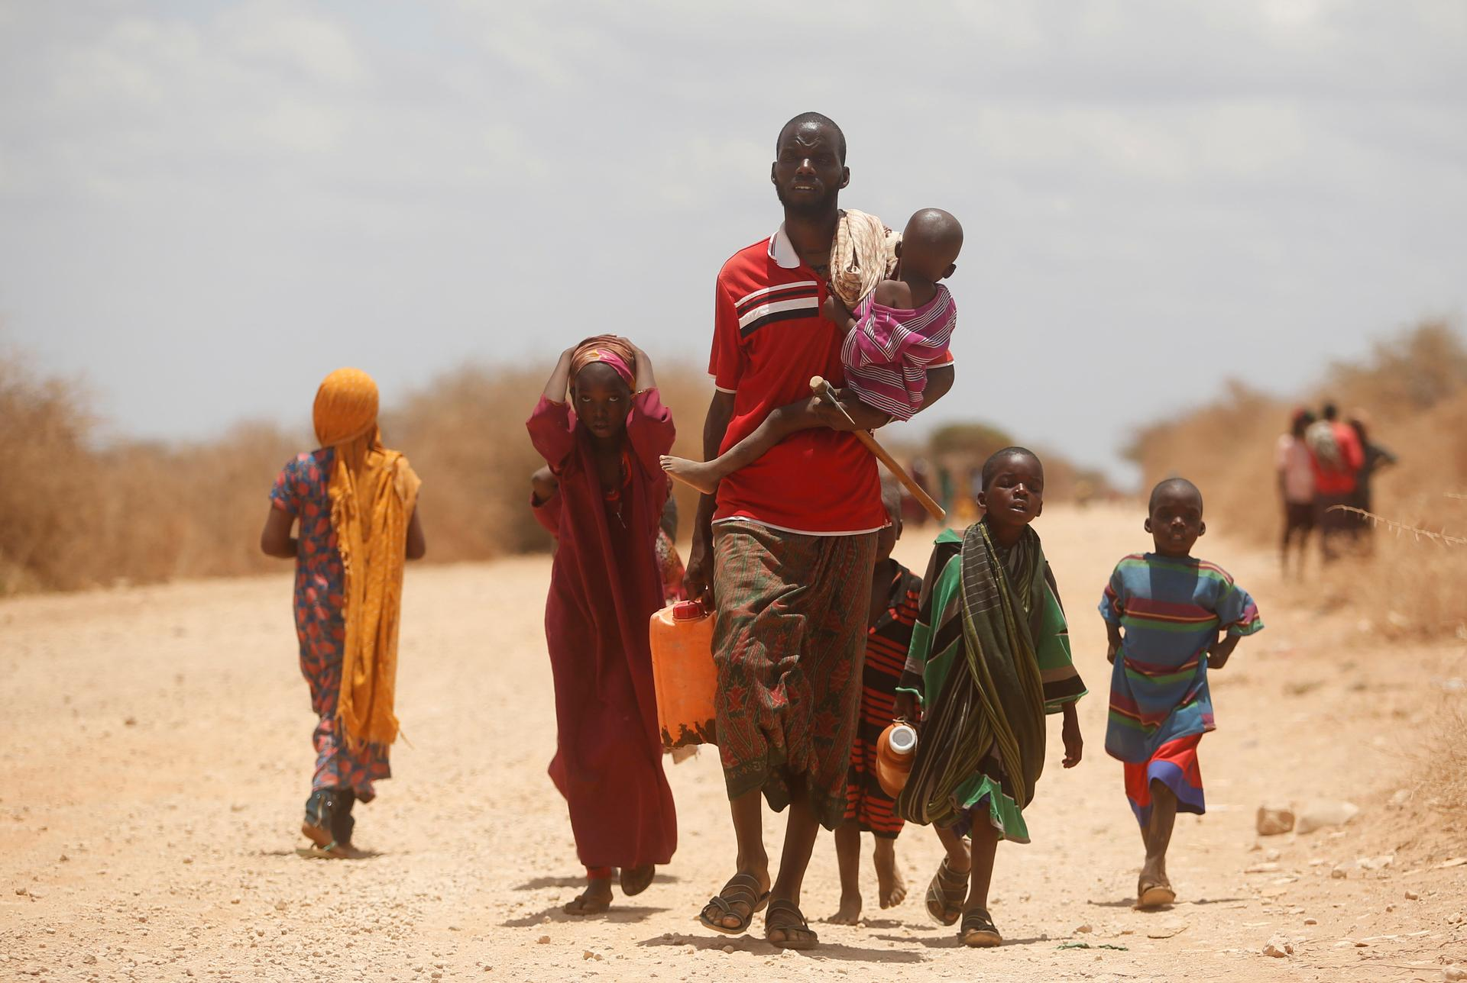
What has climate change got to do with children’s rights?
Many parts of Somalia have recently suffered from severe droughts and floods because of climate change. Around 43,000 school-age children have been affected.
The drought has been especially devastating for those who depend on farming for their living. Crops are ruined and farmers cannot make a living.
Some farmers move to other places in search of water, food and grazing pasture and have to take their children out of school.
Somalia is also a country where there is lots
of conflict. Climate change is making the conflict worse and people fight over the resources that are becoming increasingly scarce.
Notes:
I’ve got an amazing fact for you. The whole country of Somalia has emitted the same amount of co2 in the last 70 years as the USA has wait for it, in the last 3 days!

Slide 8
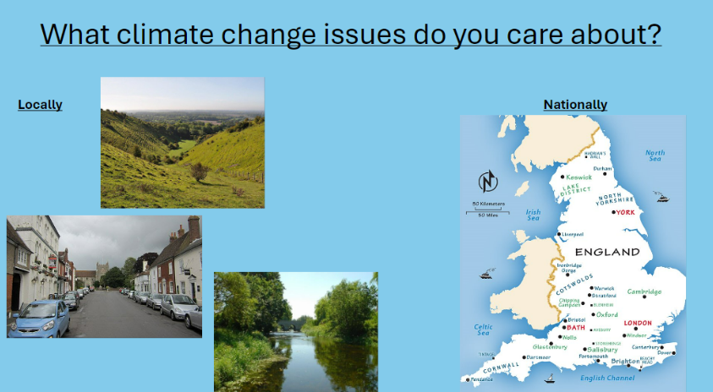

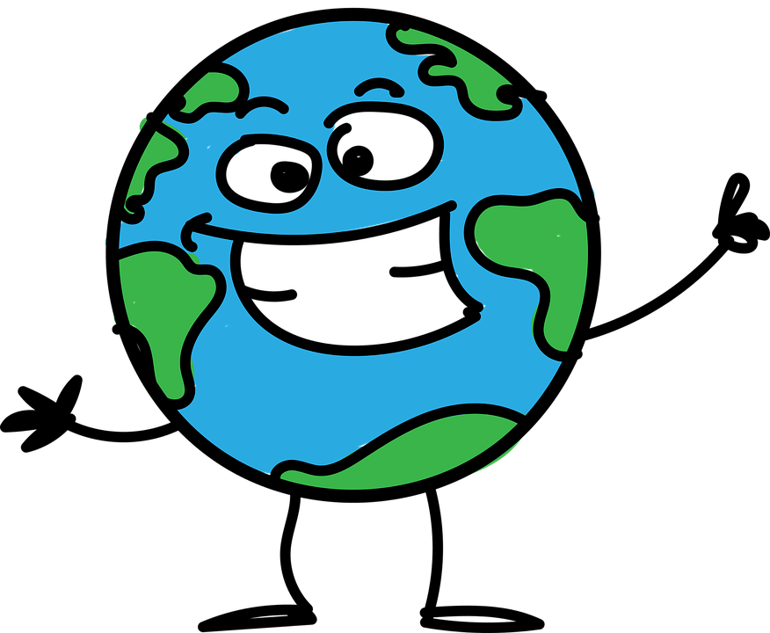
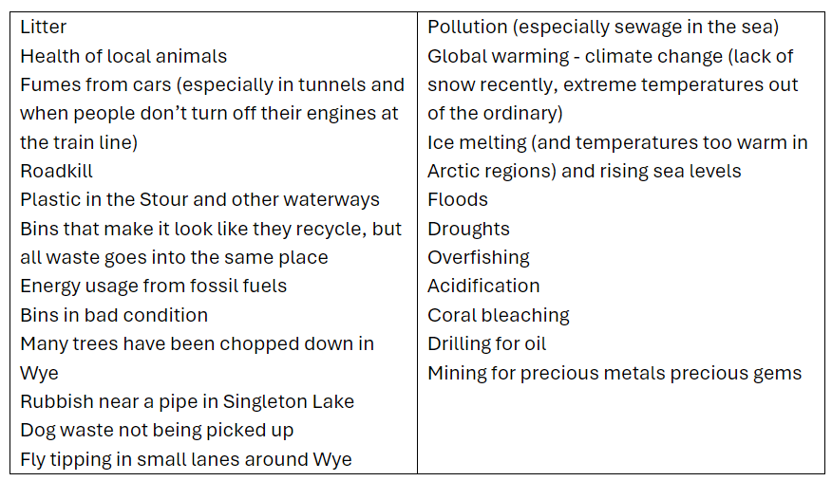
What can we do to help?
The Lady J Action on Climate Change launch!
Notes:
This all sounds very sad but the good news is that we can all do something to help the situation. Last year, Miss Llewellyn talked to you about various environmental issues, including climate change, and you all came up with issues that you thought were the most important. This is the list in fact of those priorities. On Friday, the School Council are going to look at this list of priorities and come up with 5 actions that we are going to do as a school community, involving parents, the governors and maybe even people who live locally to us. So, if you have any brilliant ideas of things that we could do, for example some sort of event, then please speak to the school councillors in your class. They will then come to the meeting armed with your suggestions and we can decide which of those suggestions we are going to put into action.

Slide 9
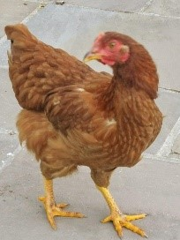
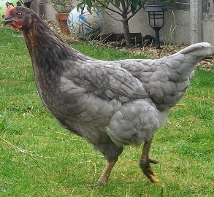
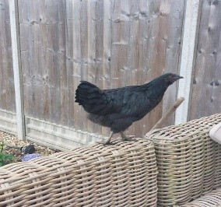
Introducing…
Ginger
Cluckinson
King Bob

