Slide 1

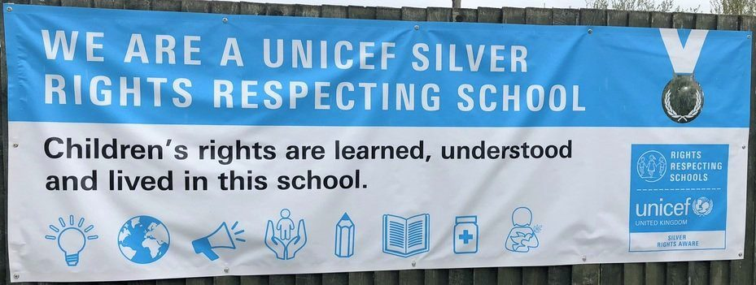

Slide 2


Slide 3

Rights are Universal.

Slide 4

Rights are Inherent.

Slide 5

Rights are Inalienable.

Slide 6

Rights are Unconditional.

Slide 7

Rights are Indivisible.

Slide 8
"Rights are for all children, they are there from birth, they cannot be taken away, they do not have to be earnt and they are equally important."

Slide 9
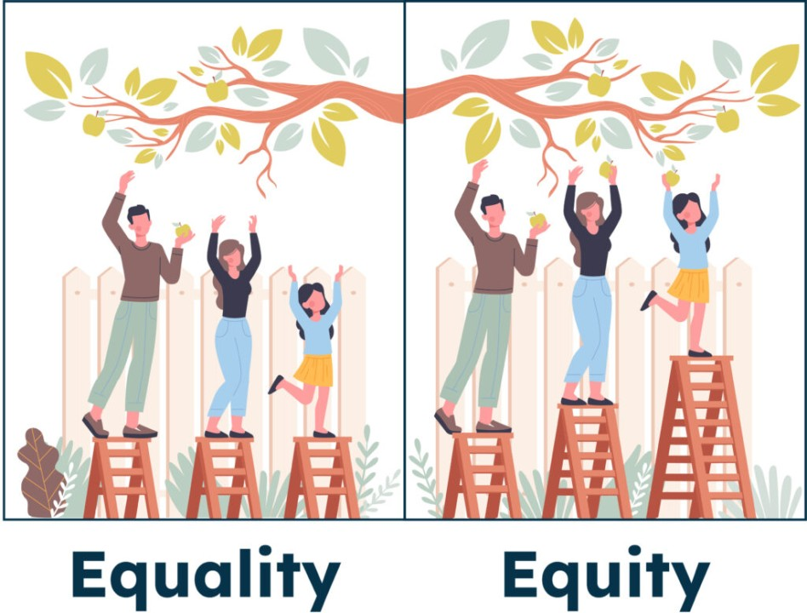
What is the same/different in the two images?
What does equality mean?
What does equity mean?
How might this look in our classrooms?
Can you think of a time when you have needed some support to achieve a goal?

