Slide 1
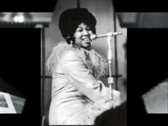
Notes:
Which school rule do you think my assembly might be on today?

Slide 2
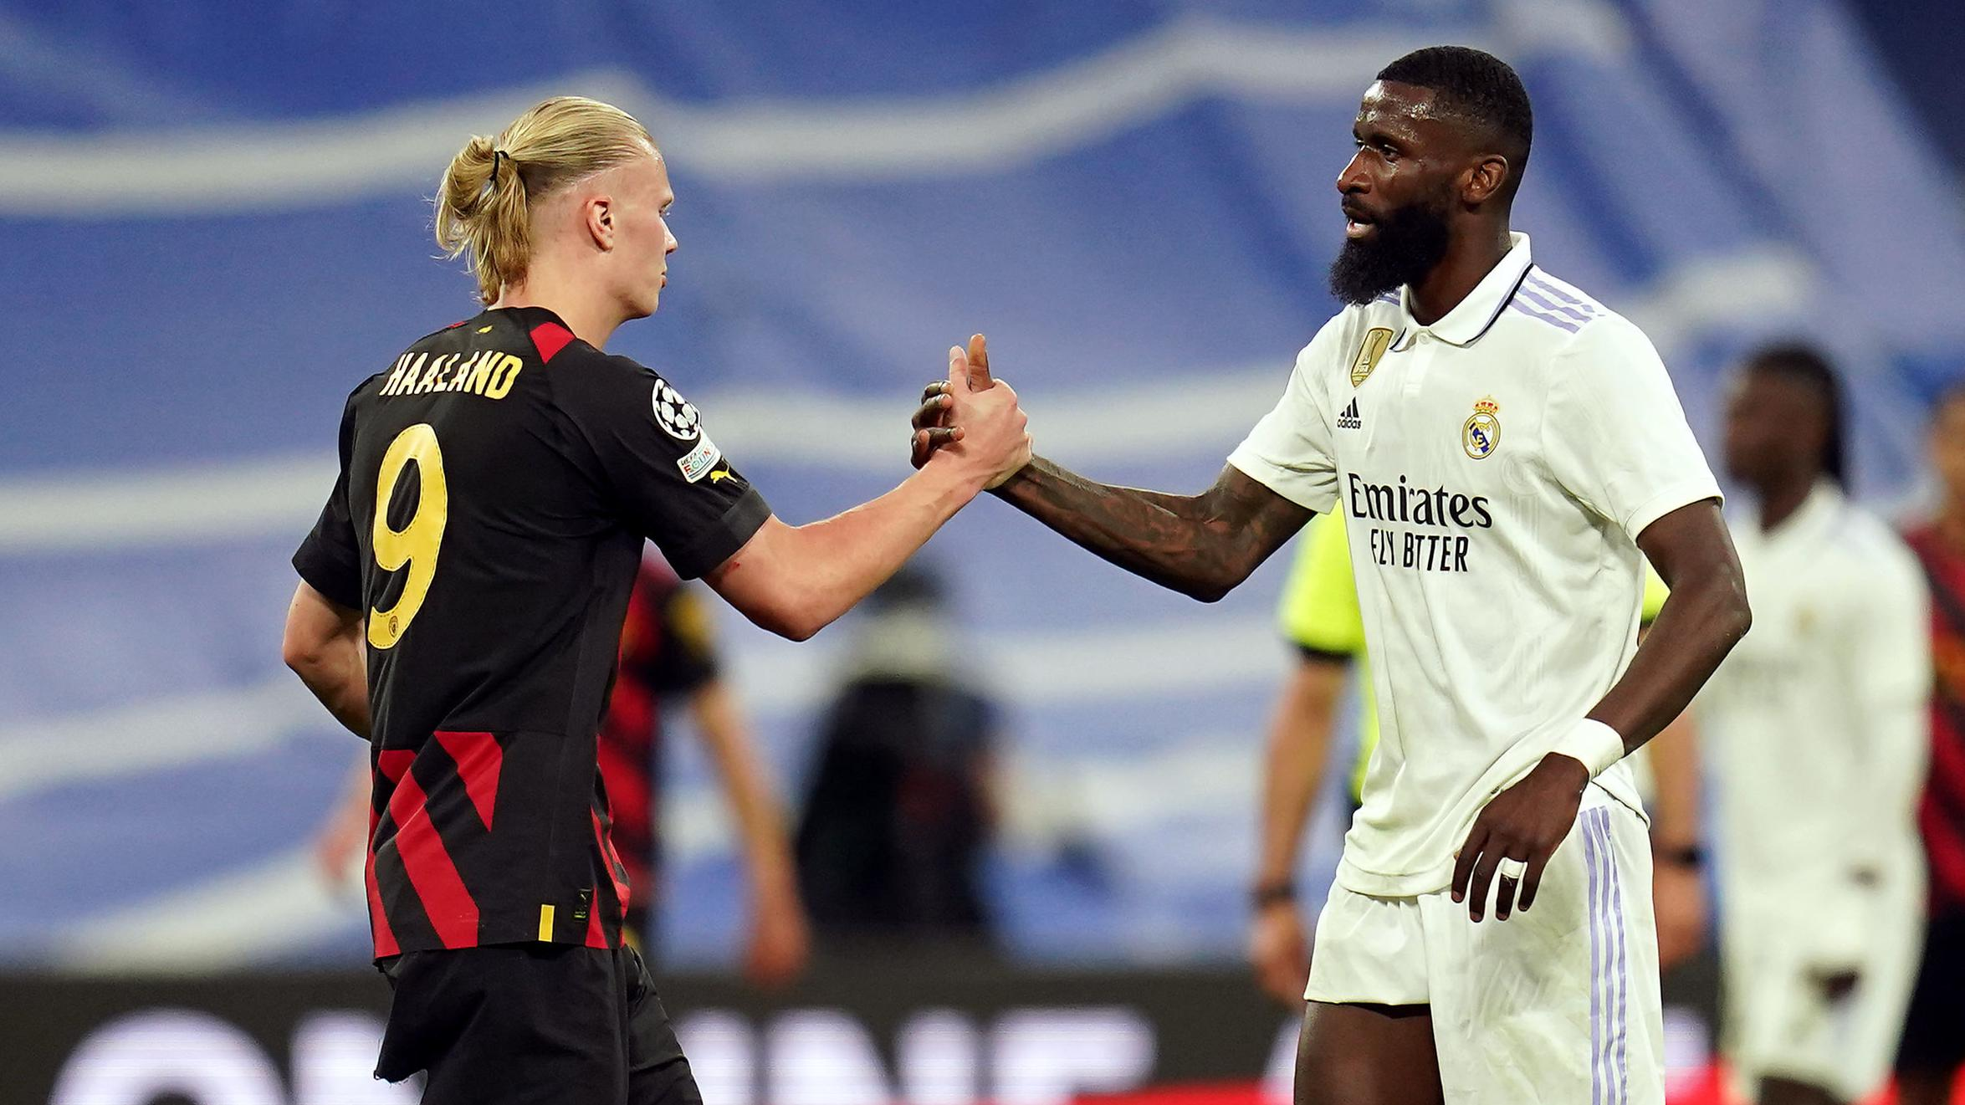
Mutual Respect
British values - Mutual respect - BBC Teach
Notes:
: Why do players shake hands before a match? Gather the children’s opinions. Establish the handshake is a way of showing you intend to play fairly and value your opponents. Tell the assembly: A handshake is a mark of respect. And mutual respect - respect between one another - is what today’s assembly is about. Indicate the words ‘Mutual respect’ on the display image. Explain: the word ‘mutual’ means shared between people. Now ask: But what does ‘respect’ mean? It’s a word you hear a lot, especially in school. What does respect mean to you? Gather and list the children’s suggestions. End with: Here is what pupils Amelie and Shaeya found out when they asked people in their school community what respect means to them.

Slide 3
listen
tolerance
understanding
dignity
treat others well
equal

Slide 4
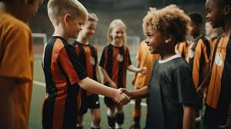
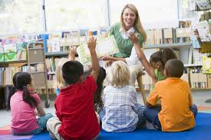
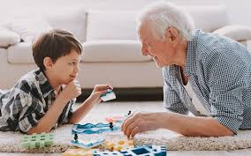
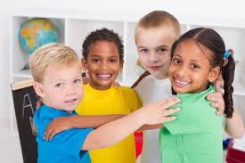
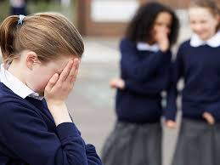
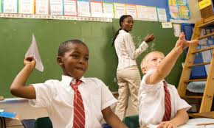
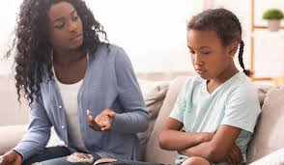
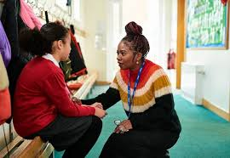
Is it always easy to be respectful? When might it be difficult?

Slide 5
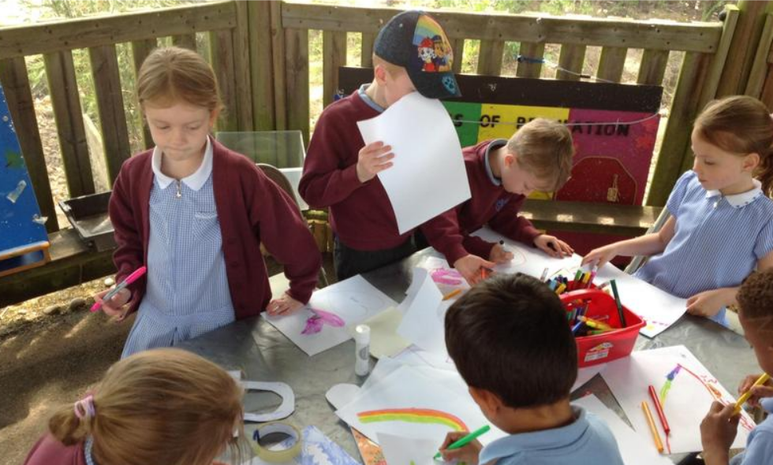
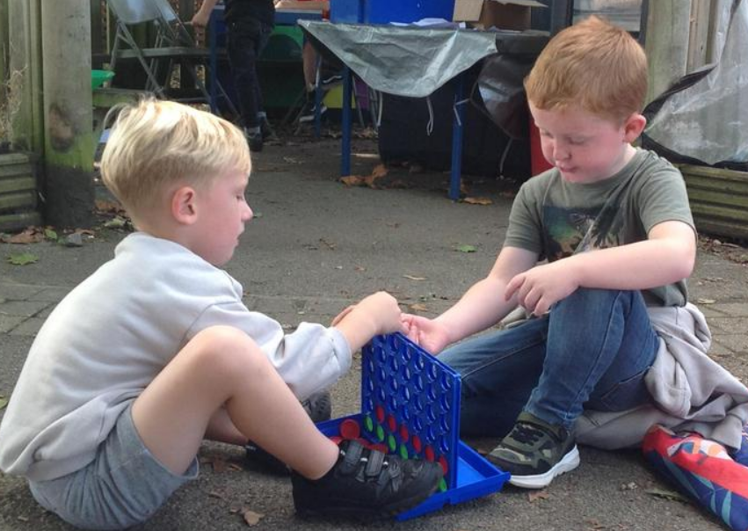
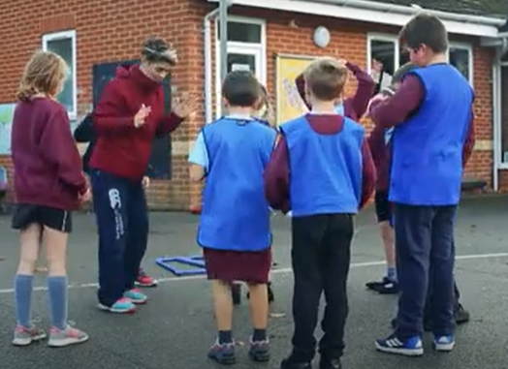
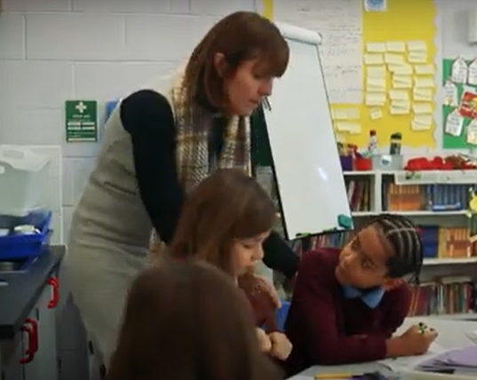
What does mutual respect look like at Lady J?
How are you respectful to each other and to adults?
How are adults respectful to you?

Slide 6
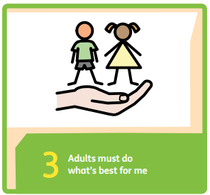
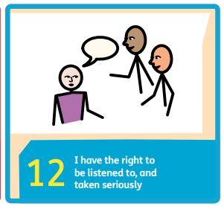
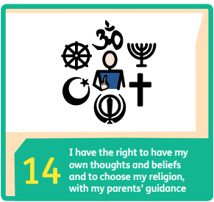
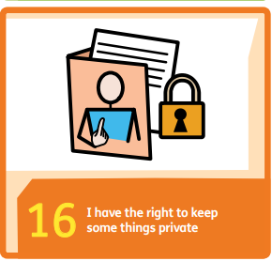
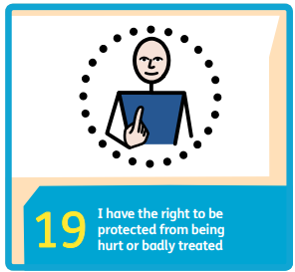
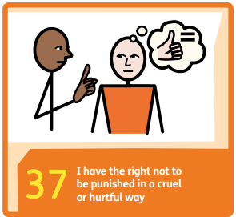
We are a Rights Respecting School – of course respect is important to us!
Notes:
As duty bearers, all adults at this school are making sure you can enjoy the rights that you are entitled to. All of your rights have respect at the core but I’ve selected just some of the rights that I think are particularly about respect you talk to you about today.
3 – You are all very important. Your health, your wellbeing, your education are all very important to us so we make sue that we always do what is best for you.
12 – the adults value your view and opinions. We show you respect by listening to what you have to say. It’s why we have our SC. It’s why we ask you to contribute in lessons – lessons aren’t just about the teacher standing at the front and talking, there’s always an element of pupil participation too. We might, for example, in an English lesson, ask you tell us what you think about a book or a character in a book.
14 – we respect and celebrate diversity in this school and part of that is welcoming people of different religions and valuing everyone’s thoughts and opinions, even if those thoughts and opinions are different to our own. You might completely disagree with a friend about something but being respectful towards each other means accepting that other people may think differently to us and that’s ok. Some people in this school believe in God and have strong views about their religion, others perhaps don’t believe in God or don’t belong to a particular religion but we all respect each other.
16 – respecting other people’s privacy is really important and nobody should be pressured into sharing information that they are not comfortable sharing.
19 – self explanatory. If we respect people then we treat them as we would want to be treated.
37 – You all know that if children at this school don’t make good choices, for example if they disrupt learning for others in the class or they treat someone in an unkind way, then there will be consequences for that behaviour, e.g a yellow or red card or a missed playtime or perhaps a conversation with Mrs Foster and the purpose of those consequences is to help the child see what went wrong and to help them think about making things right and how they might behave differently in future. The purpose of these consequences IS NOT to make children feel frightened or silly or embarrassed and that’s because we respect the dignity of every child in this school. Respect for human dignity means that we should be friendly and kind to others and it is wrong to hurt other people or make them feel bad about themselves.
Remember dignity means someone’s importance and worth as a person. Every human being is unique, important and special. This is what we mean by dignity and dignity underpins all children’s human rights. You have all these rights plus all the others because you are all important and worthy of respect.

Slide 7
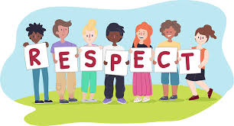
How will you show respect today?

