Slide 1



ANTI-BULLYING WEEK 2024

Slide 2


Slide 3
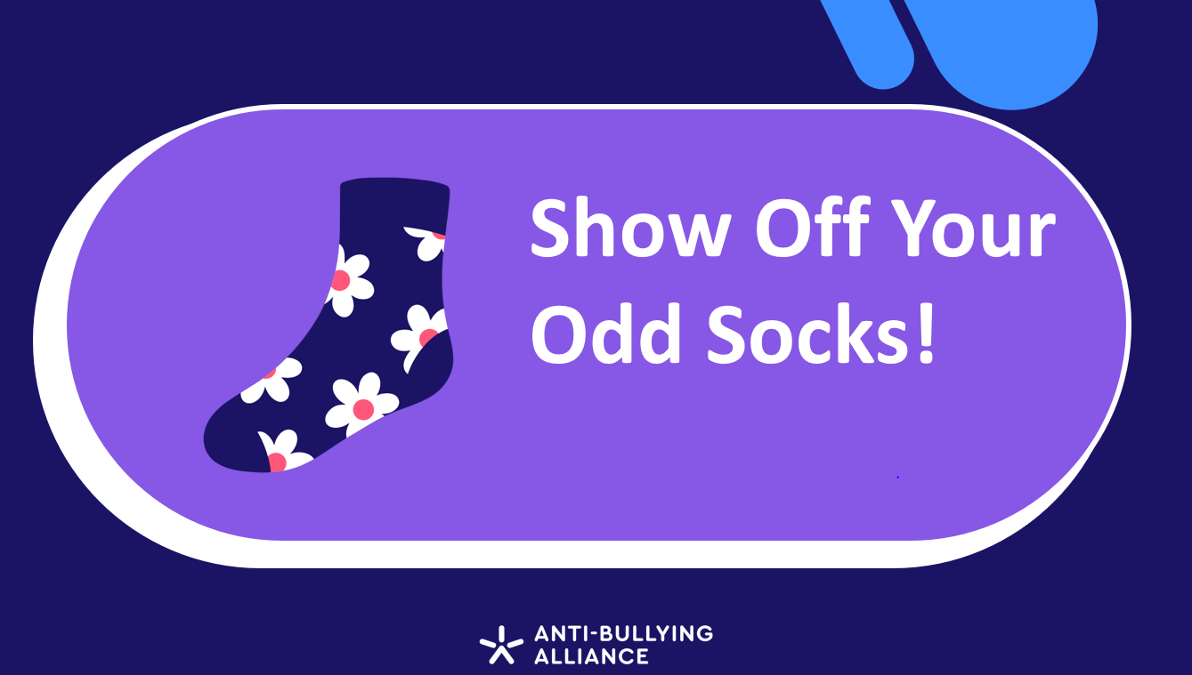
Show Off Your Odd Socks!

Slide 4




LINKED UNCRC ARTICLES
Article 2 (non-discrimination) - The Convention applies to every child without discrimination, whatever their ethnicity, gender, religion, language, abilities or any other status, whatever they think or say, whatever their family background.
Article 12 (respect for the views of the child) - Every child has the right to express their views, feelings and wishes in all matters affecting them, and to have their views considered and taken seriously. This right applies at all times, for example during immigration proceedings, housing decisions or the child’s day-to-day home life.
Article 13 (freedom of expression) - Every child must be free to express their thoughts and opinions and to access all kinds of information, as long as it is within the law.
Article 19 (protection from violence, abuse and neglect) - Governments must do all they can to ensure that children are protected from all forms of violence, abuse, neglect and bad treatment by their parents or anyone else who looks after them.
.

Slide 5


CALL TO ACTION
https://youtu.be/sZ_CkltlgS4

Slide 6
“
WHAT IS RESPECT?
Oxford Languages definition:
Have due regard for (someone’s feelings, wishes, or rights).
“

Slide 7
“
WHAT IS BULLYING?
Anti-Bullying Alliance’s Definition:
The repetitive, intentional hurting of one person or group by another person or group, where the relationship involves an imbalance of power. Bullying can be physical, verbal or psychological.
It can happen face to face or online.
“

Slide 8
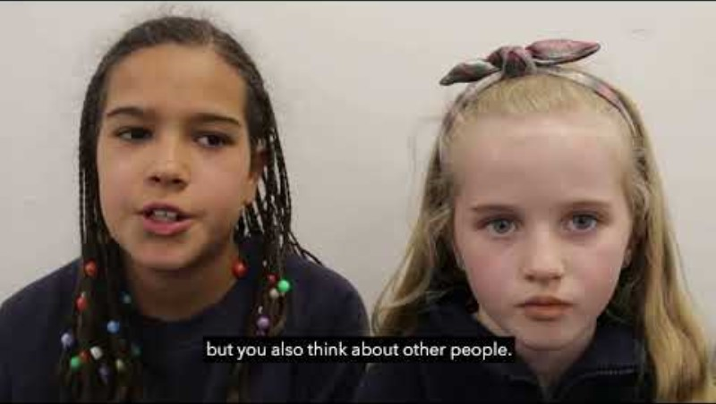
https://youtu.be/UmI5hbQTIUw

Slide 9


ANTI-BULLYING WEEK: PRIMARY SCHOOL VIDEO
What was the message in the film?
How can we show respect to each other in school?
Should we be showing respect to everyone?

Slide 10


WE CHOOSE RESPECT PLEDGES
Group Discussion

Slide 11

WHO CAN YOU SPEAK TO AT SCHOOL?
Staff name here
Staff name here
Staff name here

Slide 12



ANTI-BULLYING WEEK 2024
Monday 11th to
Friday 15th November
Odd Socks
Day 2024
Tuesday 12th November

