Slide 1
Everyone under the age of 18 has these rights.
All children have these rights.
Adults must do what's best for me.
The government should make sure my rights are respected.
The government should support the right of my family to help me know about my rights.
I should be supported to live ad grow.
I have the right to a name and belong to a country.
I have the right to an identity.
I have the right to live with a family that cares for me.
I have the right to see my family even if they live in a different country.
I have the right to not be taken out of the country illegally.
I have the rights to be listened to and taken seriously.
I have the right to find and share information.
I have the right to have my own thoughts and beliefs and chose a religion.
I have the right to meet friends and join groups.
For teacher reference

Slide 2
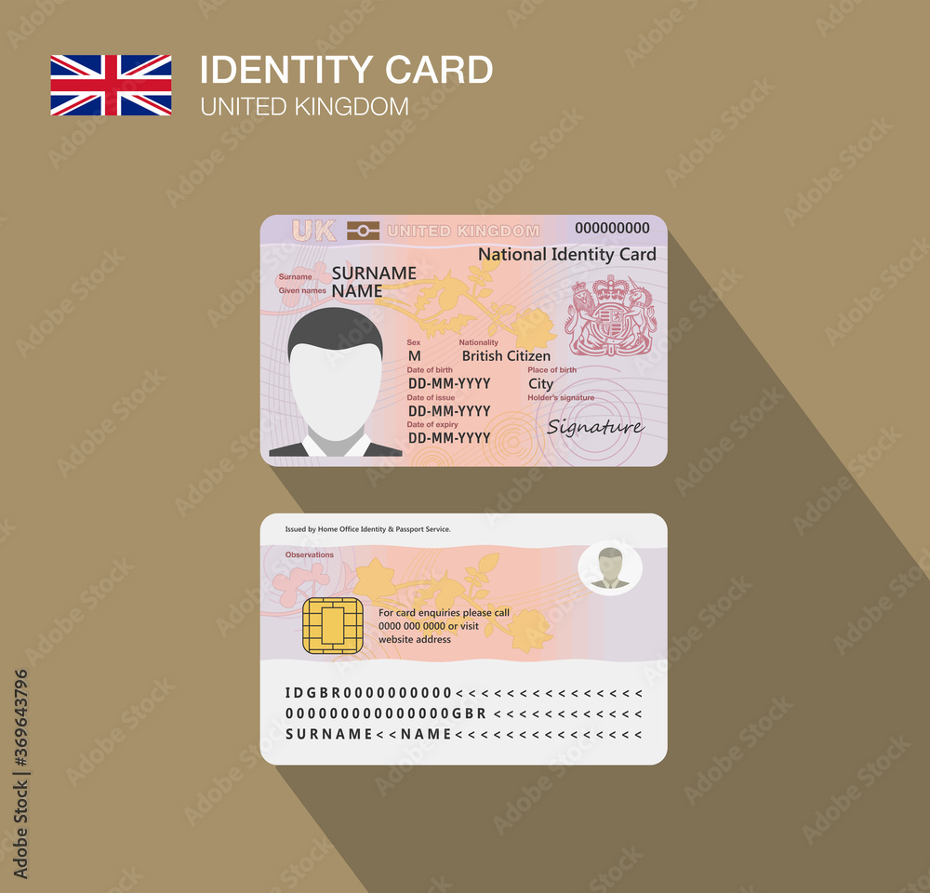

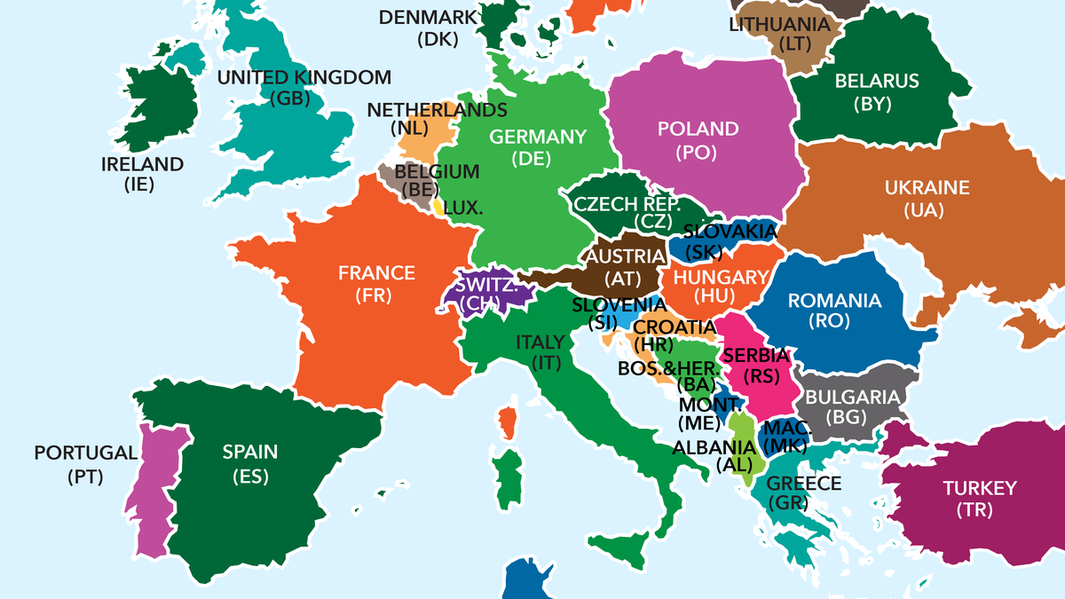
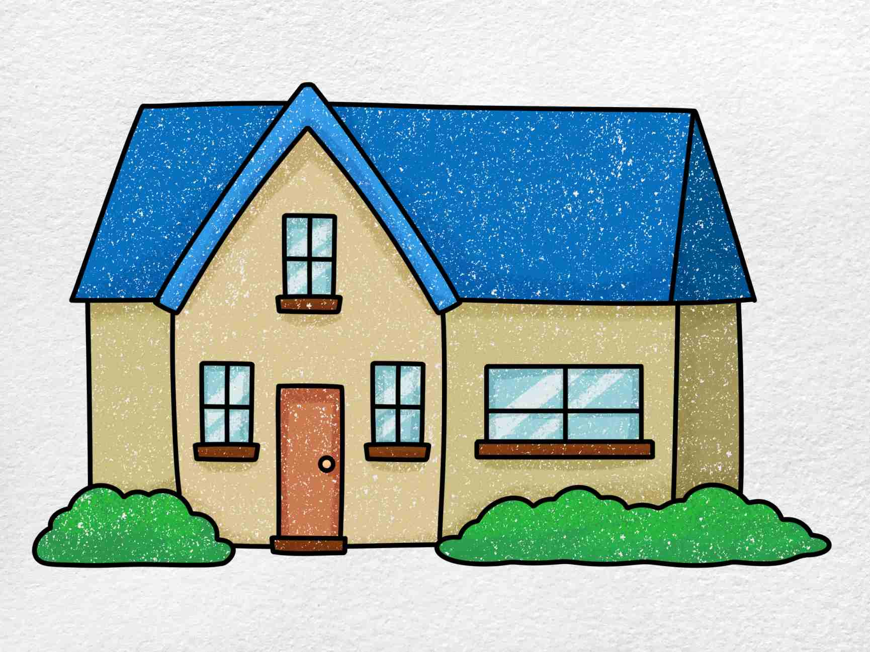

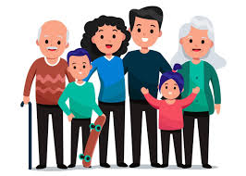

Article 7
Article 8
Article 9
Article 10

Slide 3


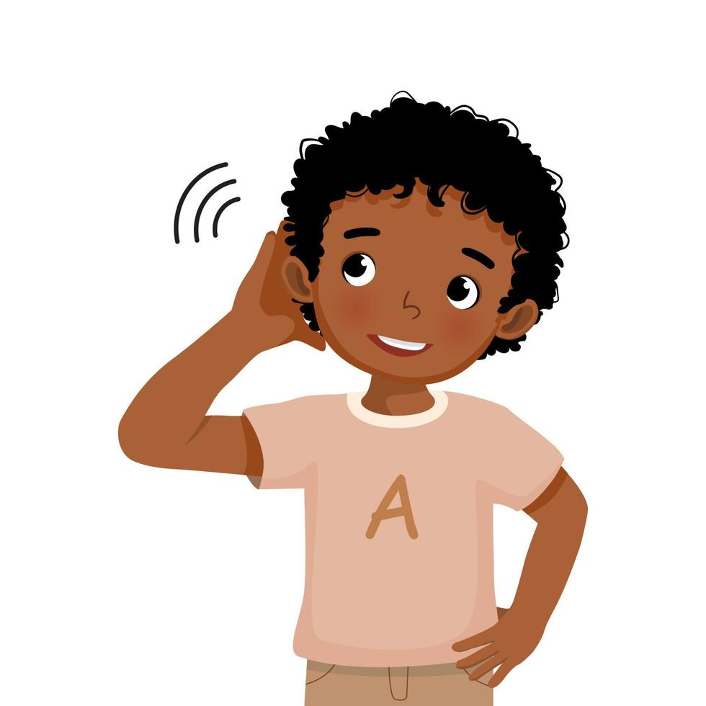
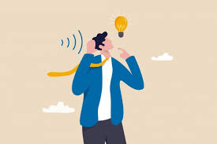

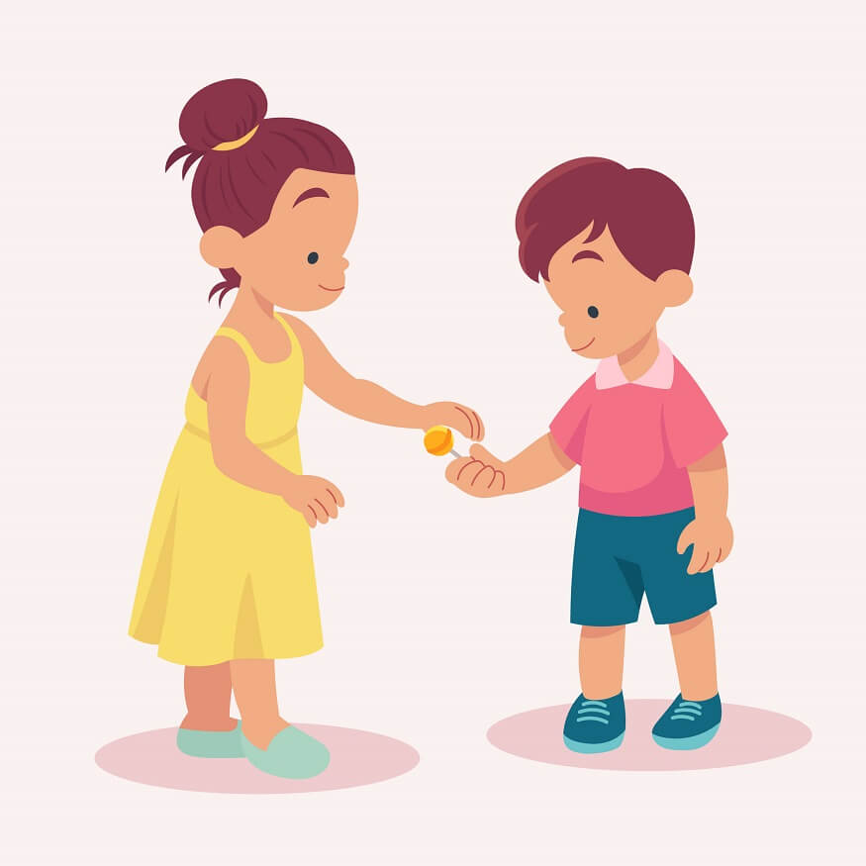

Article 11
Article 12
Article 13

Slide 4

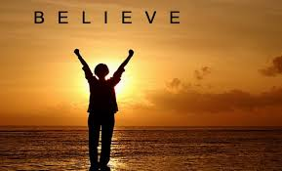

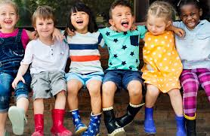
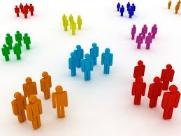
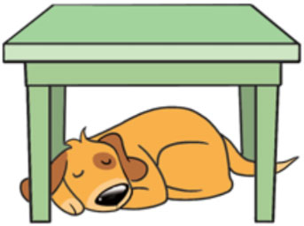


Article 14
Article 15
Article 1

Slide 5


Today is WORLD CHILDREN’S DAY!

Slide 6

What Is World Children’s Day?
What Is Universal Children’s Day?
It is celebrated on 20th November every year.
This is a special day because it is the date when countries in the United Nations adopted the Declaration on the Rights of the Child.
It was created by the United Nations to raise awareness about the rights of children everywhere. It's a day to remind the world that all children, no matter where they live or how old they are, deserve to be treated with respect, kindness, and love.
Notes:
The United Nations General Assembly is a group of countries who want to work together to help everyone have a safe and happy life with equal opportunities to a fair society.

Slide 7
Why is World Children’s Day important?
What Is Universal Children’s Day?
Sadly, not all children in the world have the same opportunities. Some children don’t have enough food to eat, clean water to drink or a safe place to sleep. Others might not be able to go to school or play with their friends because of war, poverty of climate change.
World Children’s Day is a chance to stand up for those children and make sure their voices are heard.
Notes:
Not all children get to enjoy the rights that they are entitled to.

Slide 8

Notes:
A video which shows children from many different countries around the world writing letters in their own languages to adults to make them aware of their rights and to express their wishes for their future and the future of the world. You won’t be able to understand a lot of them because they are speaking in their own languages but you may be able to read the subtitles to understand what they are saying but if you can’t read it because it does go very quickly, it’s ok to just watch and you will be able to see from their faces just how passionate they are about children’s rights.
Some of them talk about their wish for a peaceful world where they will be safe from the dangers of war, some of them talk about climate change and the flooding and droughts that this causes, some of them talk about their right to education and their right to be protected from harm and at least two of them talk about having their voices heard and being included in making decisions that affect them.
So I think that was a very powerful video with a powerful message. And that message is that by respecting and protecting children’s rights, we will create a better, safer, happier, fairer world for all children.

Slide 9
How can we help?
What Is Universal Children’s Day?
As a Rights Respecting School, we are already doing lots of great things to protect the rights of children at this school. You can protect each other’s rights by:
Being kind and respectful to your classmates and others, no matter their background.
Standing up for others who may be treated unfairly or who need help.
Learning about different cultures and people around the world to understand their lives better.
Support charities that help children in need, such as those providing food, education, or healthcare.
Notes:
Duty bearers = We always do what is best for you, we make sure you can enjoy your right to play and relax, we give you an education that develops your personality, talents and abilities through the various clubs on offer and other opportunities outside of the classroom such as trips and sporting events, we make sure your voices her heard and your thoughts are respected.
We support the Ashford Food bank. Who can remember which charity we were supporting last Friday?

Slide 10

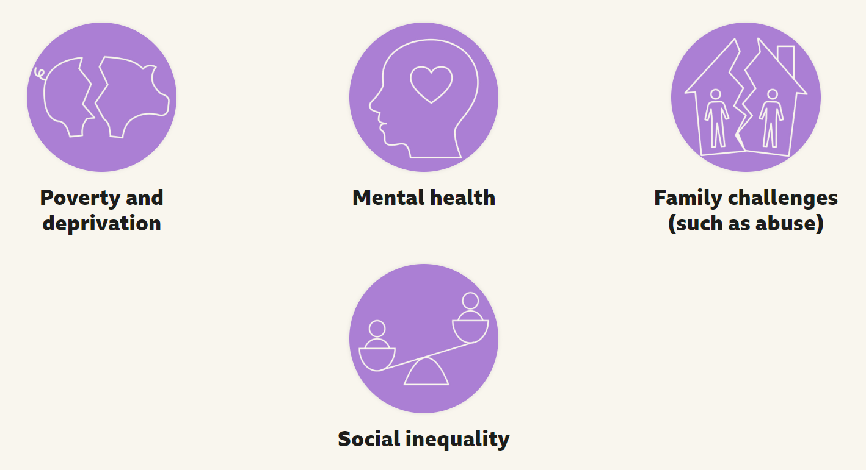
You have also done great work to protect the rights of children all around the country!
Children’s Rights are at the core of all the work that Children In Need does. Thanks to the generosity of your families, many more children all around the UK will be able to enjoy many more of the rights that they are entitled to.
Notes:
They help children living in poverty whose families may not be able to provide enough food or clothing or a safe and warm home for their children, they help children with disabilities or perhaps have mental health problems to enjoy their rights to play and relax or to make friends and join groups or to get an education. And they do lots of other really important things too to give children a better quality of life.
So when we did our sponsored silence on Friday, you were helping children like those. Thanks to the generosity of your families and friends who donated money for the silence, more children are now able to enjoy more of the rights they are entitled to. Its events like this that show that we really are a rights respecting school. One that uphold and protects the rights not only of children within this school but the rights of children all around the UK.
But it doesn’t stop there. In fact, today many of you and your families have done something which shows that you also care about the rights of children all around the world.

Slide 11

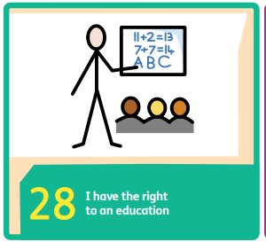

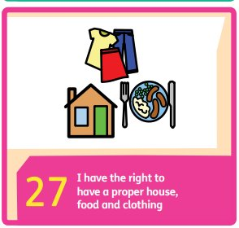
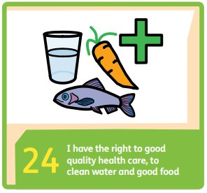
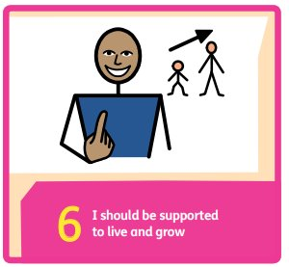
You have also done great work to protect the rights of children all around the world!
Lady J Ditch the Car Day
Notes:
Today is the first ever Lady J Ditch the Car Day. Today, many of your parents and carers made a pledge to leave their cars at home and travel to school by a different means. By doing so, you have stopped loads of CO2 from going into the atmosphere and causing global warming. We know about the disastrous effects of climate change – the flooding and the droughts. You may well have seen on the news the recent terrible flooding in Spain. But lots of you took action against that today and therefore made a small step towards ensuring that more children can enjoy their rights such as a right to an education, the rights to healthcare, clean water and food, the right to a safe home. ARTHUR??

Slide 12

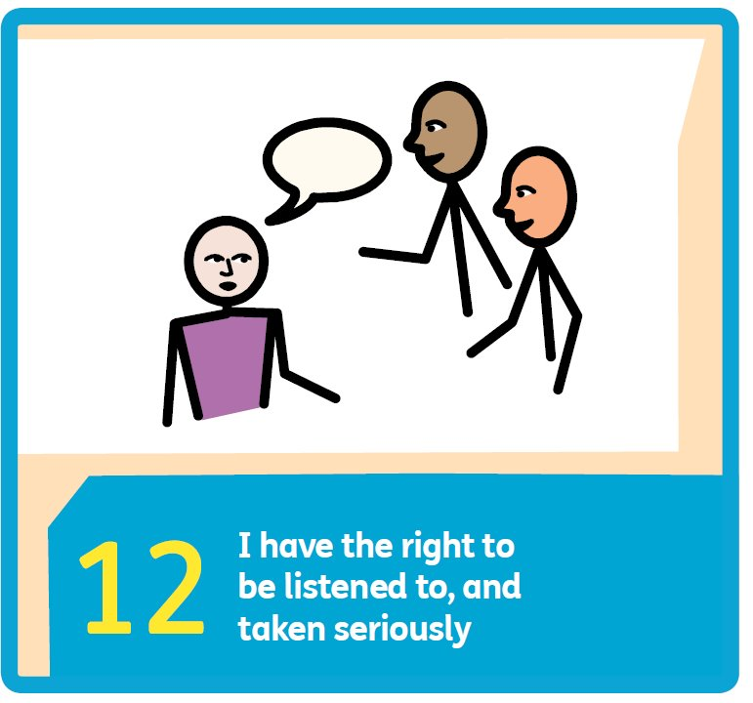
What else could we do?

