Slide 1
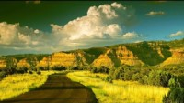

Slide 2
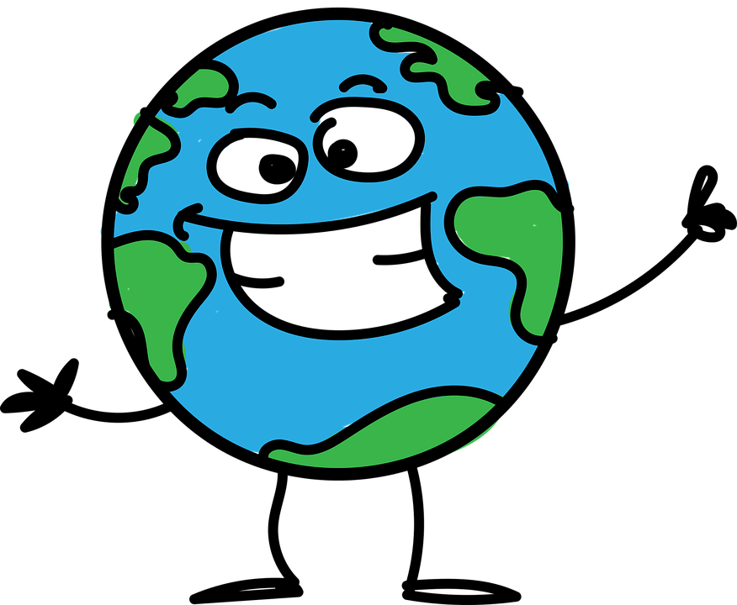
The Lady J Action on Climate Change launch!
Notes:
Last week in assembly, we talked about what climate change is and the problems that it causes. Can anyone remember any of the consequences of climate change that we talked about? Think about the weather changes. We also talked about how climate change can affect children’s rights.

Slide 3
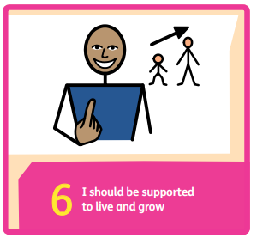
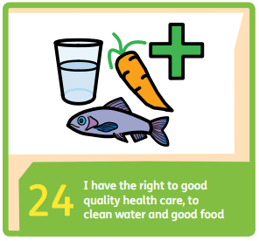
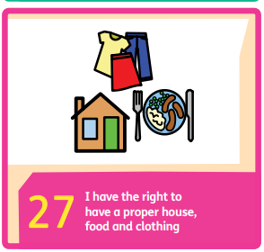
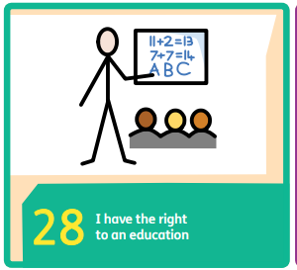
How does climate change affect children’s rights?
Notes:
Can anyone remember what we discussed about how climate change can affect children’s rights?
Danger to life
Flooding can prevent access to healthcare and education.
Droughts and flooding can mean that crops are ruined and so people don’t have access to enough food.
Water quality can be affected by flooding.
If crops are ruined, farmers can’t earn a living and provide for their families.

Slide 4

Notes:
The good news is that there are actions we can all take to help, even you as children can do your bit. I’ve got a video to show you now. The girl is this video is a very famous environmental activist. That means that she works hard to ensure world leaders are taking climate change seriously and are doing lots to help with the problem. Her name is Greta Thurnberg. She is now a young adult but she was only a child when she started caring for the environment and trying to teach others to care too.
So her message to you is that nobody is too young to care for the environment and make a difference. There are actions that we can all do to help.

Slide 5
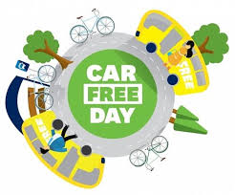
Action 1: Ditch the car day.
Notes:
So on Friday, the school council met and decided upon 5 actions that we can do as a school to help tackle climate change. The first one is a ditch the car day. Last week we talked about how cars burn fossil fuels and release carbon dioxide into the atmosphere. These gases act like a blanket, trapping the heat from the sun into the earth and that is why the earth is getting warmer. So the SC decided that one day every term, parents and teachers should try to leave their cars at home and think of alternative ways to travel to school. For example, we could walk to school or take a bus or a train. Some of you might choose to cycle to school or scoot to school. Now we know that it is not possible for everyone to do this. If you live far away and not near a bus or train route, then the only way for you to get to school might be by car and that’s ok. Some of you though might be able to share a car journey with another family if you live near to someone else that comes to this school. That would help because there would be one less car on the road than if you both went in separate cars. Now we haven’t got a date for this day yet but we will let you and your parents know as soon as we do.

Slide 6
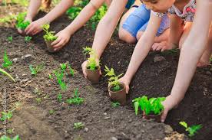
Action 2: Plant trees
Notes:
The next action the sc decided on was a tree planting day. Thinking back to our assembly last week, can you remember why trees are so important for tackling climate change? So again, we don’t have a date for this yet but at some point over this year, we are going to arrange for some children and possibly their parents to come and plant some trees.

Slide 7
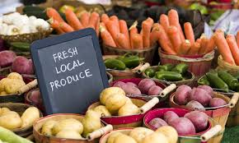
Action 3: Eat local produce.
Notes:
Action 3 is about eating food that is grown locally and in season. Does anyone know why it is better for the environment for us to buy and eat, say carrots, that are grown at a farm down the road, rather than carrots from another country? It’s why we should eat food that is in season too. If you want to eat strawberries, for example, they grow in this country in the summer. That’s when they are at their juiciest and sweetest. If you ate strawberries this summer, the chance are that they were grown locally. If you want to eat strawberries in the winter, those strawberries will have to be flown over from another country in an aeroplane and aeroplanes, as we know emit co2 which causes climate change.

Slide 8

Action 4: Litter picking club.
Notes:
Action 4 is to hav3 a litter picking club. When litter breaks down and decomposes, it releases co2 so we need to reduce the amount of litter there is. It is also dangerous for the wildlife. This will most probably we a lunchtime club and we can go out onto the school field, possibly down to the tennis court and pick litter. Show of hands.

Slide 9
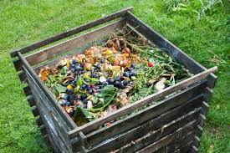
Action 5: Composting and recycling bins in school.
Notes:
Putting your food waste such as your apple cores or your banana skins into a compost bin rather than a normal bin, again prevents co2 from being released into the atmosphere. So the sc have decided we need more compost bins as well as recycling bins for plastic to be placed around the school. Terry to meeting.
So these are the 5 actions the sc have come up with. We are not going to do them all at once -we will spread them out throughout the year and hopefully, we will begin to make a positive difference to climate change and we can build on these changes year after year.

